Slide 1

Year 12 Welcome Evening

Slide 2
School Vision
At Allerton Grange, our KLAS curriculum is the driving force behind advancing social mobility and celebrating cultural diversity.
Allerton Grange’s continual improvement will ensure that, by 2025, we are delivering an exceptional quality of education for all students.
Allerton Grange is committed to ensuring that all students have the subject knowledge, the vocabulary, the experiences, and the character to secure places at world–renowned universities and on elite training programmes, which will enable them to make aspirational career choices.

Slide 3

KLAS Curriculum
The KLAS curriculum at Allerton Grange ensures that students know and remember more; they read and understand more and their character and confidence grows. Our student leadership programme enables students to take on additional responsibilities. We invest heavily in developing our staff and ensuring each team member grows as a professional.

Slide 4
The jump between GCSE and A level is not an easy one but we are here to support students with it.
Curriculum content is significantly harder and it is naïve of students to believe they can coast through their A-levels no matter how academically able they are.
Research has shown that past performance does not guarantee future performance.

Slide 5
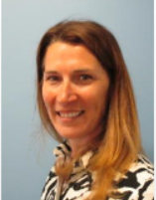
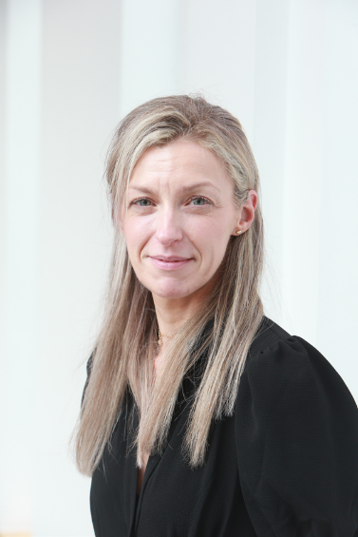
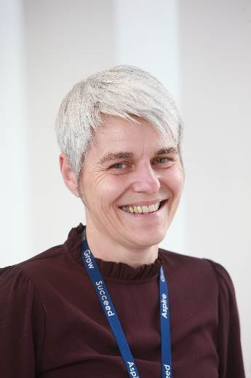
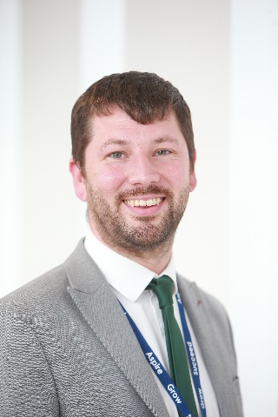
The Sixth Form Team
Mr Jordan Macrow | Mrs. Kat Knox-Renshaw
Assistant Headteacher Director of Key Stage 5 | Curriculum Leader of Key Stage 5
Jordanmacrow@allertongrange.com | Katknoxrenshaw@allertongrange.com
Mrs. Racheal Fryer | Mrs. Izzy Gillibrand
Progress and Welfare Manager of Key Stage 5 | Sixth Form Administrator
RachaelFryer@allertongrange.com | Izzygillibrand@allertongrange.com

Slide 6
Behaviour Expectations
The Sixth Form Code of Conduct operates around our Freedoms and Expectations that all students in Year 12 have agreed to in their application.
Handout Provided

Slide 7
Sixth Form Dress Code
While students have the freedom of a less restricted dress code than the rest of the school, Allerton Grange Sixth Form is still a place of learning based within a school community. This means that business-like attire is more appropriate for this setting based on the dress code below:
No jogging bottoms
Skirts and shorts should be of an appropriate length i.e. knee length
Midriffs should not be visible
Discreet facial piercings are permitted
Lanyards must be worn at all times
If a student is found to be in breach of these guidelines they will be asked to go home to get changed.

Slide 8
16 – 19 Bursary Information
Financial support is available to those students most in need, throughout their time in the Sixth Form, using the 16 - 19 bursary fund. This fund has three levels of eligibility criteria.
Those students who can prove that they are eligible may claim the 16 - 19 bursary fund to support them with food, travel, equipment, books, university trips and open days, and course costs such as materials, trips and visits.
The three levels of eligibility are:
A student who is currently in care or is a care leaver
A student who already claims free school meals
A student whose household income is less than £25, 000
To claim the 16 - 19 bursary fund, students must complete the application form via our school website or collect a hard copy from Mrs. Gillibrand, and return it to the Sixth Form office.
Students who are eligible for the bursary can also apply to borrow a school laptop for the year.

Slide 9
Form Time Expectations
Students are expected to attend all Form session every morning.
Monday – Forward Planning
Tuesday and Wednesday – Aspirational Enrichment
Thursday – Assembly, UCAS, PSHE
Friday – 1:1 Conversations, students only need to attend if they have one

Slide 10
Supported Study
Students will have supported study listed on their timetables and these should be attended just as any other lesson.
These sessions are designed to give them access to IT facilities so that they can complete independent work. This is work directed by teachers to ensure that they have recovered, revised and understood the material.
It is also an opportunity to ensure that notes and files are up to date and in good order; catch up on any learning that students may have missed; read up on their subjects to broaden their knowledge and prepare for aspirational University and higher level degree apprenticeship applications.

Slide 11
Aspirational Enrichment
5 A-side football | Debate Club | Conversational French
Gym Sessions | Space and Astronomy | Politics and affecting change
EPQ | Film and Media Analysis | Reading Club
Progression Module | iDea Award | Seminar Studies Group
Chemistry Club | Maths Puzzle Group | Sketching for Mental Health
British Sign Language | Pachama Project: (A period poverty charity)

Slide 12
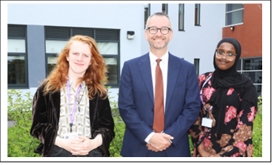
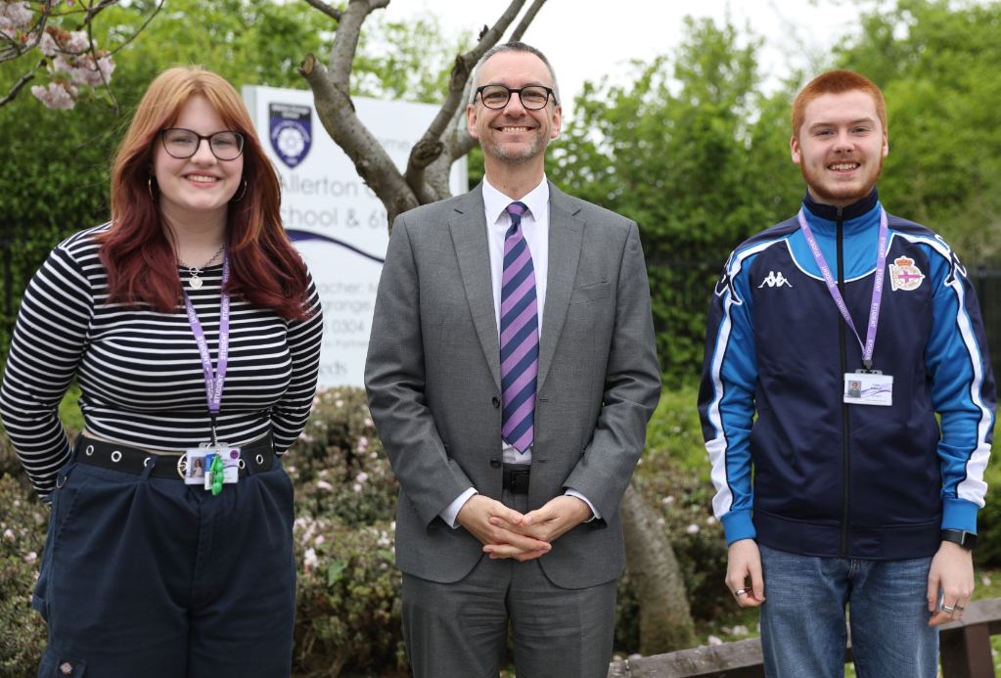
Student Leadership
Allerton Grange Sixth Form are particularly proud of their student leaders. The student leadership group comprises of two head students, 5 deputy head students and a group of student leaders. To be a member of the SLG candidates are chosen by application and interview. The head students represent the school at a number of community events and are expected to give presentations to parents, students and teachers when required. The group also work on their own initiatives each year and are the Sixth Form representatives.

Slide 13
Community Action
Allerton Grange Sixth Form has community as one of its core values and driving principles. To develop responsibility and wider skills, students are expected to undertake 30 hours of community action.
This is a programme where students volunteer either inside or outside of school and can take action through a range of mentoring schemes. For example, reading or support with subjects and the wider school community

Slide 14
Aspirational Careers Support
University visits
Individual Careers Meetings
Careers talks
University speakers
Apprenticeship speakers & workshops
UCAS personal statements workshops
Aim High Programme
University subject taster days
Mock interviews
Work experience
Unifrog- online careers programme

Slide 15


Aim High Programme
Carry out surveys to identify who would be the first from their family to go to university
Host in school university application sessions
Run trips e.g. to Selwyn College, Cambridge
Providing information via the school’s website
Provide information via the Aim High Microsoft Teams
Run an enrichment group
Offer support for those applying to Leeds University’s Reach for Excellence programme
Publicise opportunities such as Sutton Trust summer schools, etc.
Host talks by university students

