Slide 1
Sixth Form Open Evening
3rd November 2022
Mr Roper – Headteacher
Mr Macrow- KS5 Director (Assistant Headteacher)
Miss Braim – Head of Sixth Form

Slide 2
Why choose Allerton Grange Sixth Form as your A Level studies?

Slide 3
Why is Allerton Grange Sixth Form different? (Mr Roper)
Social mobility
Enrichment and extra/super-curricular activities
Pastoral care
Facilities
Applying to Allerton Grange Sixth Form

Slide 4
We add value
(2022 DfE performance data)
A Level students
20%
than similar students nationally
Vocational Level 3 students
40%

Slide 5
We build resilience
(2022 DfE performance data)
The proportion of A level students who fully complete their 2 year programme ….
Allerton Grange
= 98%
Nationally = 91%
Leeds
= 87%

Slide 6
We build futures
(2022 DfE performance data)
The proportion of Y13 students who progress onto ambitious progression routes ….
Allerton Grange
= 81%
Nationally = 66%
Leeds
= 66%
Significantly more Russell Group and Oxbridge university admissions than Leeds or National.

Slide 7
School Vision
At Allerton Grange, our KLAS curriculum is the driving force behind advancing social mobility and celebrating cultural diversity.
Allerton Grange’s continual improvement will ensure that, by 2025, we are delivering an exceptional quality of education for all students.
Allerton Grange is committed to ensuring that all students have the subject knowledge, the vocabulary, the experiences, and the character to secure places at world–renowned universities and on elite training programmes, which will enable them to make aspirational career choices.

Slide 8
KLAS Curriculum
The KLAS curriculum at Allerton Grange ensures that students know and remember more; they read and understand more and their character and confidence grows. Our student leadership programme enables students to take on additional responsibilities. We invest heavily in developing our staff and ensuring each team member grows as a professional.

Slide 9
We support students
Students will have supported study listed on their timetables and these should are attended just as any other lesson.
These sessions are designed to give students access to IT facilities so that they can complete independent work. This is work directed by teachers to ensure that they have recovered, revised and understood the material.
It is also an opportunity to ensure that notes and files are up to date and in good order; catch up on any learning that students may have missed; read up on their subjects to broaden their knowledge and prepare for aspirational University and higher level degree apprenticeship applications.

Slide 10
We support the Community
Allerton Grange Sixth Form has community as one of its core values and driving principles. To develop responsibility and wider skills, students are expected to undertake 30 hours of community action.
This is a programme where students volunteer either inside or outside of school and can take action through a range of mentoring schemes. For example, reading or support with subjects and the wider school community

Slide 11
We develop students
A unique offer at Allerton Grange Sixth Form, is the Continued Professional Development sessions. These are University level study skills sessions delivered to students once a fortnight by Mr. Macrow the Director of Sixth Form.
These sessions are designed, based on current research, to help students to learn and improve their study skills in preparation for completing A levels and preparing for university.
All students attend and engage with these sessions, which have been developed in line with student voice from the current Year 12 cohort.

Slide 12
We provide aspirational enrichment
5 A-side football | Debate Club | Conversational French
Gym Sessions | Space and Astronomy | Politics and affecting change
EPQ | Film and Media Analysis | Reading Club
Progression Module | iDea Award | Seminar Studies Group
Chemistry Club | Maths Puzzle Group | Sketching for Mental Health
British Sign Language | Pachama Project: (A period poverty charity)

Slide 13
Student Leadership
Allerton Grange Sixth Form is particularly proud of its student leaders. The Student Leadership Group comprises of two head students, 5 deputy head students and a group of student leaders. To be a member of the SLG candidates are chosen by application and interview. The head students represent the school at a number of community events and are expected to give presentations to parents, students and teachers when required. The group also work on their own initiatives each year and are the Sixth Form representatives.

Slide 14
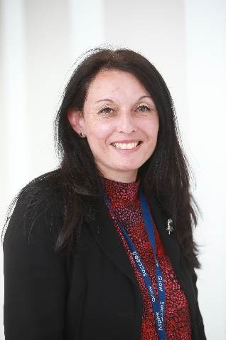
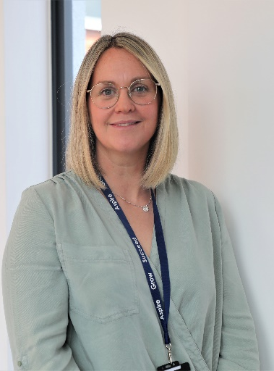
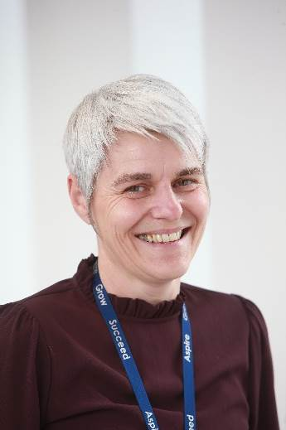
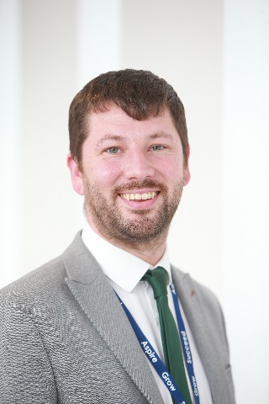
The Sixth Form Team
Mr Jordan Macrow | Ms. Elizabeth Braim
Assistant Headteacher Director of Key Stage 5 | Curriculum Leader of Key Stage 5
Jordanmacrow@allertongrange.com | Elizabethbraim@allertongrange.com
Mrs. Louise Mills | Mrs. Izzy Gillibrand
Progress and Welfare Manager of Key Stage 5 | Sixth Form Administrator
Louisemills@allertongrange.com | Izzygillibrand@allertongrange.com

Slide 15
Aim High Programme
Carry out surveys to identify who would be the first from their family to go to university
Host in school university application sessions
Run trips e.g. to Selwyn College, Cambridge
Providing information via the school’s website
Provide information via the Aim High Microsoft Teams
Run an enrichment group
Offer support for those applying to Leeds University’s Reach for Excellence programme
Publicise opportunities such as Sutton Trust summer schools, etc.
Host talks by university students

Slide 16
We provide our students with experiences beyond the classroom
Sixth Form trips
We want our students to be able to engage in activities beyond the classroom to support their personal development.
Year 12 Welcome Residential
University visits
Course related trips e.g. the social sciences London residential, theatre visits.

Slide 17
We have fantastic facilities
New building
Computer and IT access
Common Room
Study Space
Dedicated Sixth Form Teaching Environment

Slide 18
We provide excellent UCAS and careers support
We ensure that all our students can make informed choices about their futures.
Our careers support includes:
University visits, subject taster days & speakers
Apprenticeship speakers & workshops
UCAS personal statements workshops
Form tutors who have a wealth of experience and expertise.
Mock interviews
Work experience
Unifrog- online careers programme

Slide 19
16 – 19 Bursary Information
Financial support is available to those students most in need, throughout their time in the Sixth Form, using the 16 - 19 bursary fund. This fund has three levels of eligibility criteria.
Those students who can prove that they are eligible may claim the 16 - 19 bursary fund to support them with food, travel, equipment, books, university trips and open days, and course costs such as materials, trips and visits.
The three levels of eligibility are:
A student who is currently in care or is a care leaver
A student who already claims free school meals
A student whose household income is less than £25, 000
To claim the 16 - 19 bursary fund, students must complete the application form via our school website or collect a hard copy from Mrs. Gillibrand, and return it to the Sixth Form office.
Students who are eligible for the bursary can also apply to borrow a school laptop for the year.

Slide 20
We build the timetable around what our students want to study
In order to ensure that the greatest number of students get to study exactly the combination of subjects they want to do we create the option blocks after we have received student applications.
We don’t make our students choose from pre-decided option blocks- we are responsive to what the students want.

Slide 21
What our students have to say…

Slide 22
Applying to our sixth form
Allerton Grange School students: If you are currently studying at Allerton Grange School, you will be sent login details to your school email address. The Year 11 Team will support you with this as part of your Post-16 Progression.
Students from other schools: If you are an external student, please click visit the sixth form area of the Allerton Grange School website and click on Apply Now to begin your application.
Please contact the Sixth Form Team at sixthform@allertongrange.com if you have any questions.

