Slide 1
Year 11 Supporting Success Evening
Wednesday 27th September
Aspire Grow Succeed

Slide 2
Miss Drew- Assistant Headteacher- Director of KS4
Ms Moore- Assistant Headteacher- Teaching, Learning & Assessment
Mrs Mills- Careers Lead

Slide 3
Key dates for this academic year (including Year 11 PPEs and the summer examination season)
Post 16 applications (LMI)
Revision and revision guides
Academic support and intervention at AGS
Exam boards
What now: using Year 10 PPEs to feed forward (KMO)

Slide 4
28th Sept KS4/5 careers fair
2nd Oct predicted grades given to students in form
17th October Y11 parents evening
OCTOBER HALF TERM
10th November Y11 mock interviews
1st December Y11 Art, 3D and Photography PPE exams
15th December deadline for post 16 applications
CHRISTMAS HOLIDAYS
8th & 15th January Y11 MFL PPEs
22nd & 29th January Y11 PPEs
1st Feb Y11 advice & guidance (sixth form)
FEB HALF TERM
27th March Supporting Success Evening (Final Push)
EASTER HOLIDAYS
22nd April GCSE 3D Design, Art and Photography exams
29th April MFL GCSE Exams
7th May GCSE Exams begin
Notes:
Art PPE- pre Christmas, and it forms part of the coursework – 60% overall grade

Slide 5
Careers Support
Mrs Mills is the Allerton Grange Careers Lead
louisemills@allertongrange.com
I work Monday - Thursday

Slide 6
What are the options?
A Levels
T Levels
Vocational Qualifications
Apprenticeships
Traineeships
Part-time study with employment or volunteering

Slide 8
Applications and Deadlines
All colleges will consider applications as soon as they are made.
Applications will open in October (each college will vary slightly)
The majority of 6th Form Colleges will close applications in December
Do some research and be informed (grade requirements for specific courses/professions)
Students MUST to make a minimum of TWO applications!

Slide 9
Applications and Deadlines
Students must ensure that they have a realistic or safe back-up application, as well as their aspirational application.
When a course is full, it’s full!
A minimum of 5 grades at Level 4 and above is set in stone for A Levels, for very good reason. The majority of courses want a level 5 in English or Maths and some require students to have studied the subject at GCSE level.
The deadline for applications is Friday 15th December 2023

Slide 10
Careers Support
Between now and 15 December, All students in Year 11 will have a 1:1 Careers Appointment with Helen Smith, our Level 6 qualified careers advisor.
These will take place in the library and will last around 30-40 minutes.
Helen will write up some notes with links to useful information/websites and save it on each students’ Unifrog account. To access it, students need to log into Unifrog, search for ‘interactions’ in the search bar and it will come up.

Slide 11
Apprenticeships
Apprenticeships are becoming more and more popular, as they are mutually beneficial for employers and employees.
Apprenticeships are usually 80% work and 20% college.
Apprenticeships are available in a wide range of jobs and industries.
Students often apply directly to the company for an apprenticeship, in the same way as you apply for jobs.
Leeds City College does offer some apprenticeships which are advertised on their website.
Leeds College of Building also offers apprenticeships, but the student must find their own employer.

Slide 12
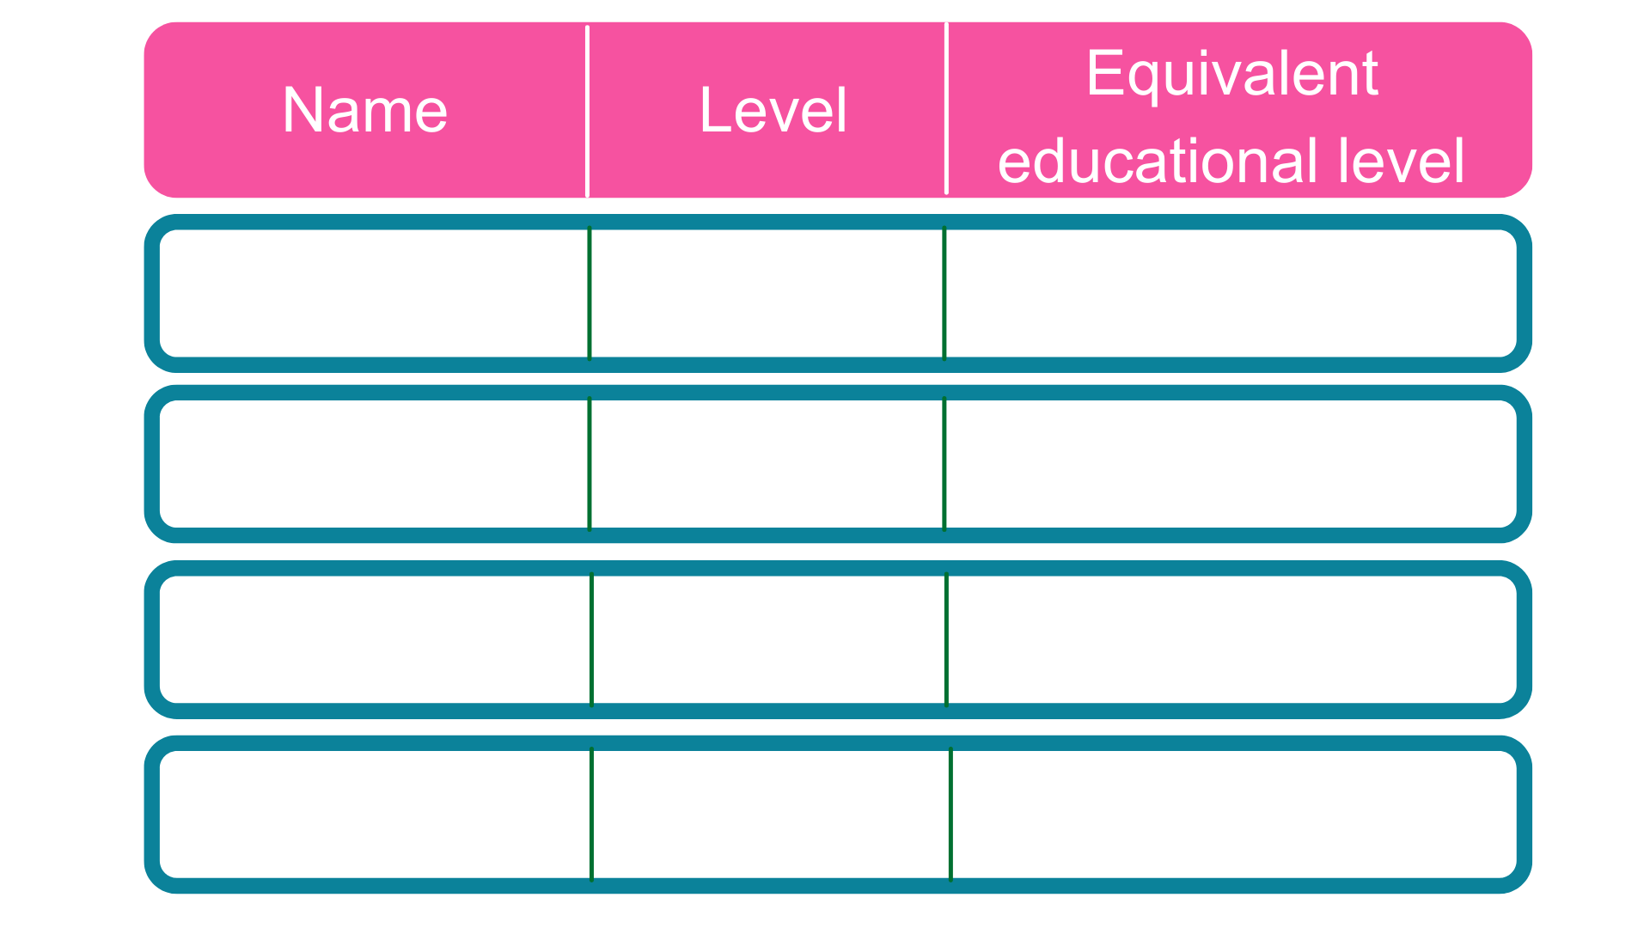
Intermediate
5 GCSE passes at grade A*-C or 4-9
2
2 A Levels / Level 3 diploma / international Baccalaureate
3
Advanced
Higher
Foundation degree and above
4,5,6 & 7
Degree
Bachelor’s or master’s degree
6 & 7
Notes:
Each apprenticeship has a level which will fall into one of the four categories above: Intermediate apprenticeships, Advanced apprenticeships, Higher apprenticeships and Degree apprenticeships.
The equivalent educational level column helps to explain what level the qualification at the end of the apprenticeship will be in comparison to more familiar qualifications, like GCSEs and A Levels.
So you can see that if you do a level 3 (advanced) apprenticeship, once you have qualified you’ll have gained a qualification that is equivalent to 2 A Levels, a level 3 diploma or other equivalents, like IB’s or BTECs.
Presenter notes: Opportunity to pause to ask if there are any questions about levels and how they work.
The level of apprenticeship you start at will depend on the kind of job that you are applying for.
It’s really important not to be held back by only looking for a particular level e.g. degree apprenticeships. Apprenticeships work a bit differently to school which can be confusing, as lots of students think that they should progress onto the next level, so if you leave after GCSEs you should do a Level 3 and if you finish after A Levels you should go for a degree apprenticeship, but this isn’t always the case.
Depending on the sector and apprenticeship, it may be that you need to start at advanced or higher level and work your way up, or that brilliant apprenticeships are only offered at Level 2 or 3 – for example, Journalism is only offered at Level 3 because that is all the industry requires.
Equally, you may be entering a completely new sector or industry that you haven’t studied or worked in before, and so may need to do a Level 2 or 3 to enter the world of work and get that understanding. Doing a job is completely different to getting a GCSE or A Level and that’s why it can be a bit confusing.
It is very important to keep an open mind so that you can explore all of the opportunities available and have multiple options available when applying.

Slide 13
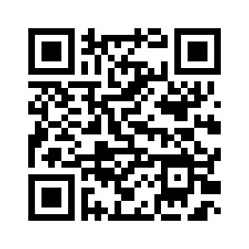
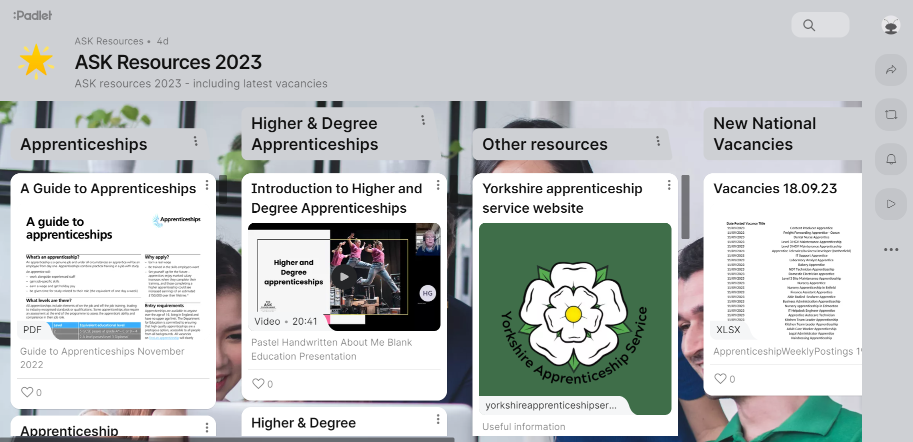
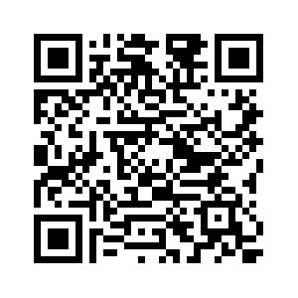

Slide 14
Retrieval practice

Slide 15
Questioning and elaboration
So now you have learned a lot of material, what should you do with it? Two of the most effective things you can do is to ask questions of what you have learned and then try to find connections between new ideas and concepts.

Slide 16
Another useful way to use concrete examples is to study the best possible example of the thing you are trying to do, such as writing an essay.
It’s very difficult to be excellent if you don’t know what excellence looks like.
By evaluating an A or A* essay and taking it apart or ‘reverse engineering it’ you will begin to learn how to put together all the information you have learned with the bigger concepts and ideas that underpin it. Ask yourself:
Spaced practice

Slide 17
Another useful way to use concrete examples is to study the best possible example of the thing you are trying to do, such as writing an essay.
It’s very difficult to be excellent if you don’t know what excellence looks like.
By evaluating an A or A* essay and taking it apart or ‘reverse engineering it’ you will begin to learn how to put together all the information you have learned with the bigger concepts and ideas that underpin it. Ask yourself:
Interleaving

Slide 18
Revision and revision guides
Revision guides are available to purchase via parent pay
If there are issues with parent pay, please contact: agadmin@allertongrange.com
Some subjects (English, History) will provide students with the guides they need. Students need to return these at the end of the year; if they don’t, they will be charged the cost of the revision guide.

Slide 19
Academic support and intervention at AGS
Academic mastery
Intervention classes led by curriculum leader from 8.30-9.15
After October half term
Subject teachers and curriculum leaders select student focus cohorts
Students may have up to 2 additional sessions a week

Slide 20
Academic support and intervention at AGS
After school sessions
Art & Photography- Weds and Thurs
Drama- arrange an evening with teachers
Other subjects TBC

Slide 21
Exam boards
AQA
Art (3D design, fine art, photography and textiles)
Biology
Chemistry
Physics
Combined Science
Drama
English Language
English Lit
French
Spanish
German
Geography
PE
RS (Short course and full course)
Edexcel
Business
History
Maths
OCR
Classics
Comp Science
iMedia
Health & Social Care (Cambridge National)
Additional Maths
WJEC
Music
Hospitality
VTCT
Hair & beauty

Slide 22
Powerful conversations
Operational changes to Assessment
How are you doing?
Are the methods to learn in class/revise working?
How could you close those gaps in your learning and skills?

Slide 23
Reflective learners
1. Plan effective revision
4.Adapt how you learn/revise
2. Monitor how it is going during the PPEs
3. Reflect and evaluate the outcomes

Slide 24
Three areas to focus on to improve GCSE results.
2. Homework engagement
Successful GCSE examination outcomes for pupils
3. Revision strategies
1. Class Engagement
October
Predicted grades given
Closing the ‘gap’

Slide 25
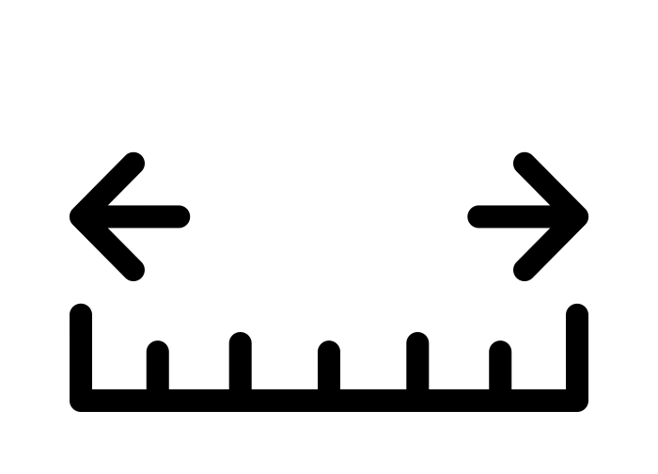
Positive next steps
 |  |  | Review: November Red. Amber, Green | Review: January Red, Amber, Green
1.
2.
3.
Target (make it specific)
How will you measure if you are have achieved the target?
Realistic deadline to have achieved the target

Slide 26
The FACE it revision model
1.
2.
3.
4.
LEARNT THE FACTS
APPLY IN CONTEXT
CONNECT IDEAS
TEST IN EXAM CONDITIONS
Flash cards
Graphic organisers
Mind maps
Knowledge organisers
Self quizzing
Tackle questions where the knowledge is tested in context – beyond straight forward recall.
Attempt questions that require students to draw on knowledge from one topic area or apply knowledge to previously unseen ideas.
Use past exam questions to rehearse the process of responding under time pressure.
Notes:
This is to help tutors explain the FACE it revision model and how it can help students to chunk down their revision and to apply learned knowledge to complex tasks. I have provided examples to guide you.

Slide 27
FACE it revision model
Students should use FACE it, to support their revision planning and as a diagnostic tool:
Have you learned your FACTs?
Have you practised Applying your knowledge in context questions?
Have you started to Connect ideas with more synoptic questions?
Have you tested yourself in timed Exam conditions?

