Slide 1

Year 11,
Supporting Success Evening
(2024-2025)

Slide 2





Agenda:
Preparing for success
Revision strategies
Careers
Well-being and support
GCSE examinations 2026

Slide 3



GCSE journey -18 month long
Year 11
210 days left
Year 10

Slide 4

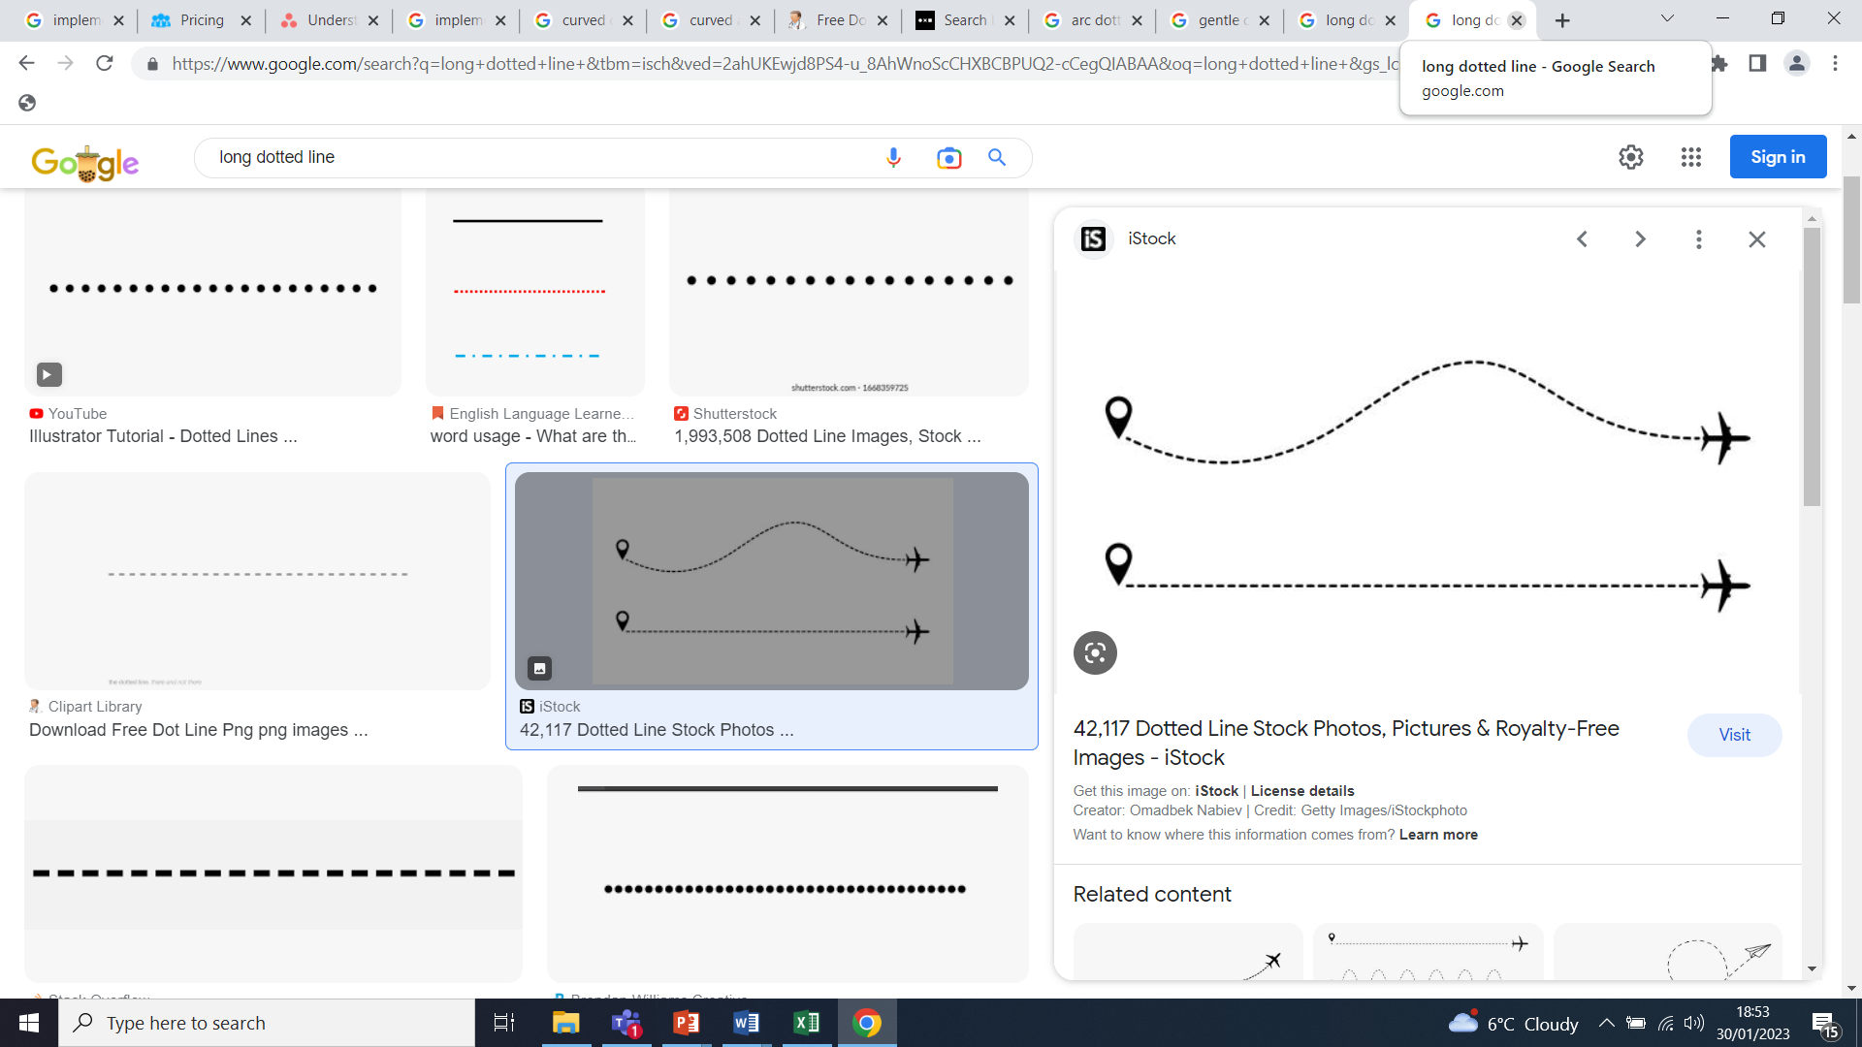





To secure success in your GCSEs
Successful GCSE results
5. Revision strategies
3. Class Engagement
1. Attendance
4. Homework engagement
September 2024
2. Organisation for learning

Slide 5
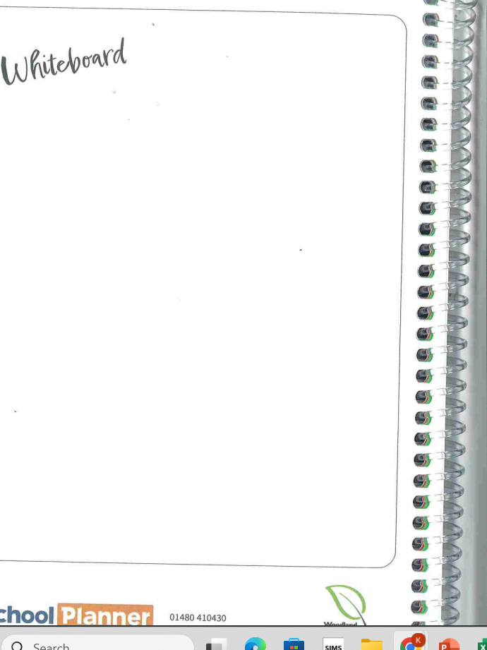
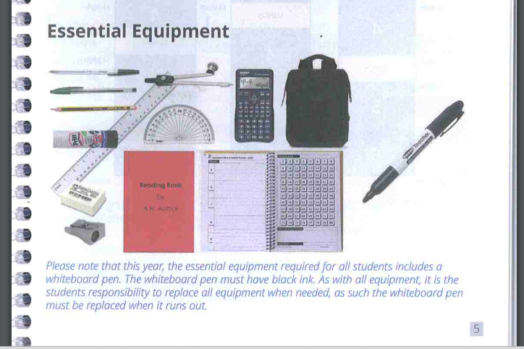
Organisation for learning

Slide 6
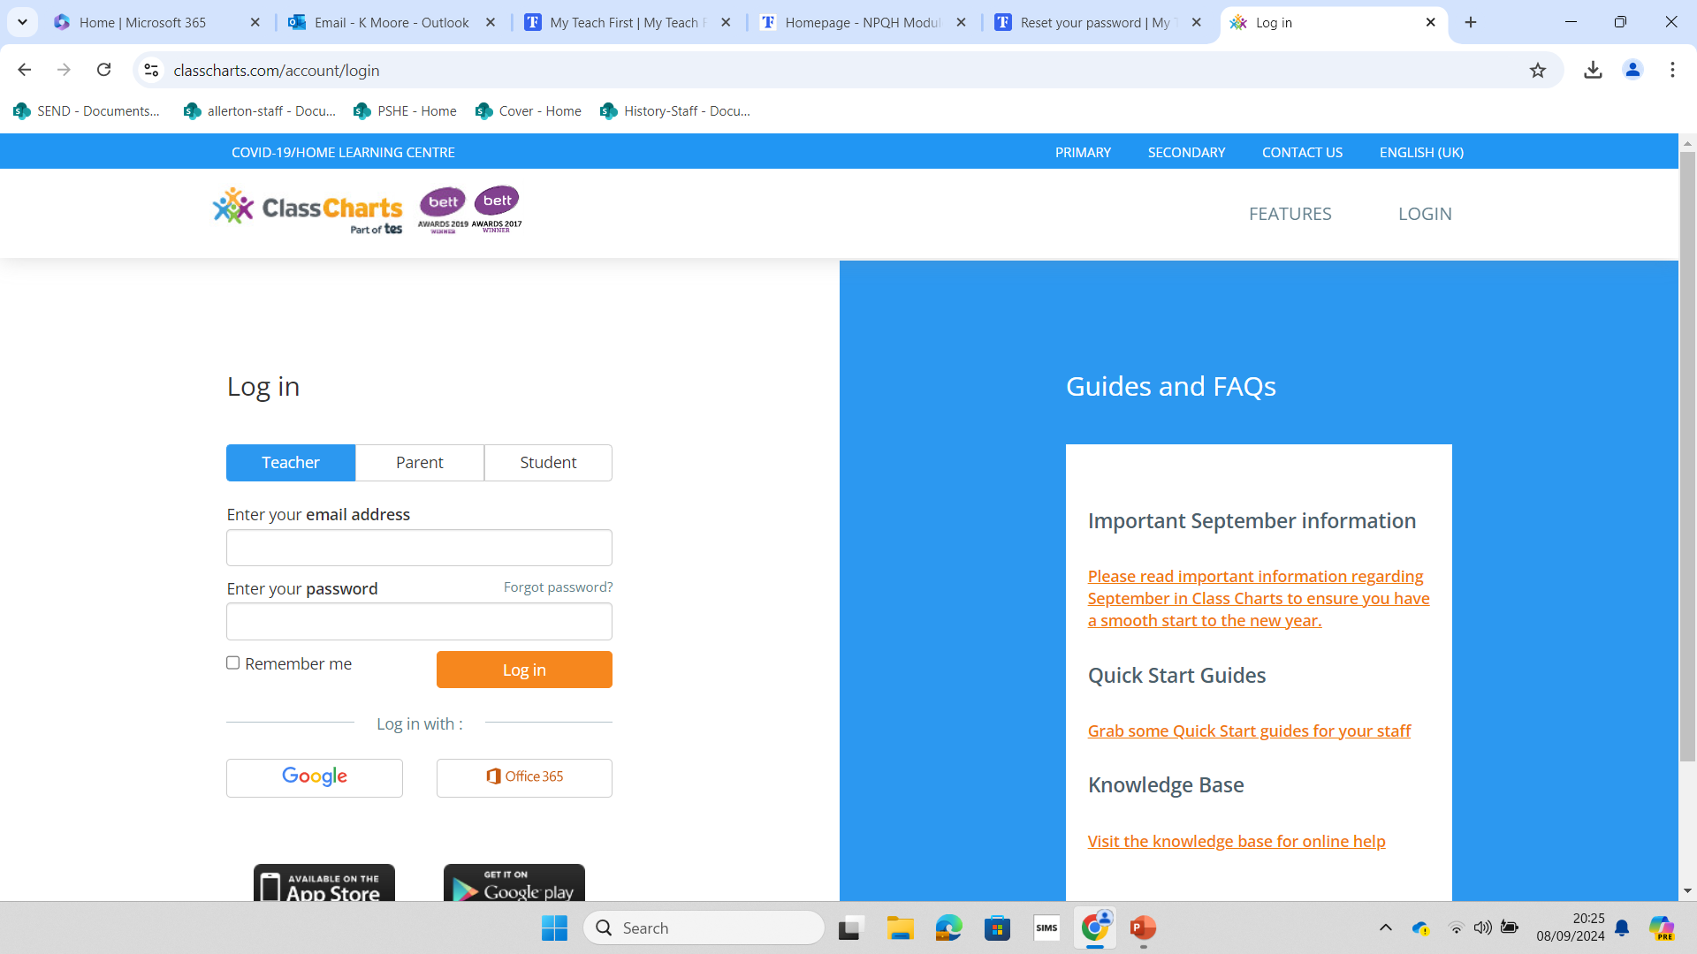





Homework and communication

Slide 7


Key dates: GCSE year (2024-2025)
Report (1) - w/c 14th October
Parents' Consultation Evening – 13th November 2024
Pre-Public Examinations: 2024 – 25th November – 6th December
Report (2) – January 2025
GCSE examinations - start date – 8th May
(need to be available for all May and all June regardless of their last GCSE date just in case of contingencies)
Results day – 21st August 2025

Slide 8
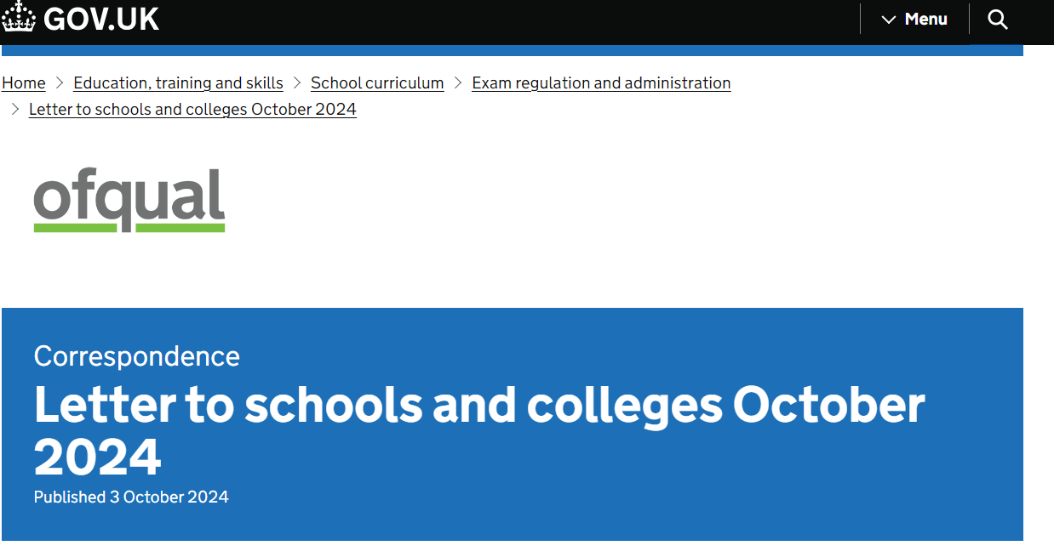
Resilience arrangements and feedback

Slide 9

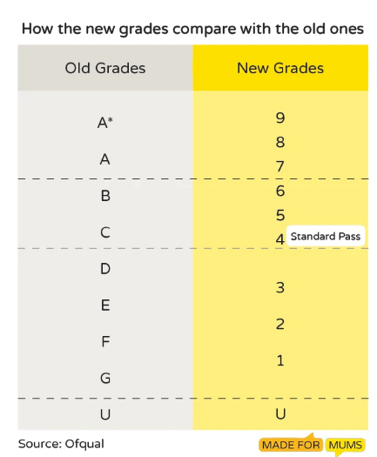
GCSE Grading system

Slide 10
GCSE expectations
Exceptional circumstances are exceptional
Return to complete pre-pandemic examinations – standards and expectations
Support your child’s attendance throughout the examination period
Malpractice and Late
We have to inform the exam board
Possible penalties e.g. marks deducted

Slide 11

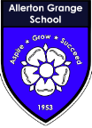
Plagiarism and Collusion
Cheating
Part of AGS behaviour policy
KS4 and KS5 – examination board notification – official investigation

Slide 12
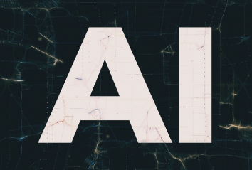
Artificial intelligence
Using it is like having a computer that thinks.
AI tools like ChatGTP and Snapchat can write text, make art and create music by learning from data on the internet – they can also make things up and be subjective.

Slide 13
Science
Triple Science (also known as single science or separate sciences)
Combined Science (also known as double science)
2 grade 5s is better than 3 grade 3s
A 7-week revision program for Science has been posted on classcharts. Please use this to revise.
Any further changes to triple/combined entry will be communicated ASAP after the PPEs.
Pathway decisions (triple or combined) will be communicated in January 2025.

Slide 14
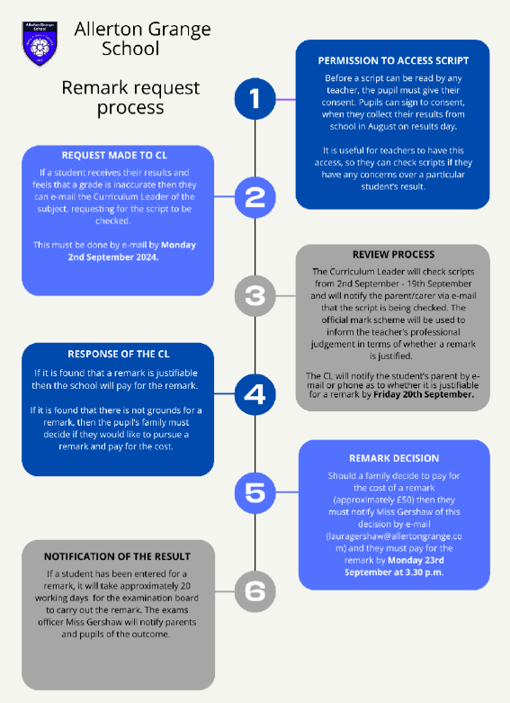
Remark process
Communicated to families in the summer term.
September 2025 decision on remarks have to be made

Slide 15


Reflecting on reports
1. Monitor how well you are doing in your subjects
3.Adapt how you learn/revise
What can you do differently to have even better success rates?
2. Reflect and evaluate the outcomes

Slide 16

Operational changes to Assessment
Parental conversations about the reports:
How are you doing?
Are you doing the learning right?
How could you do the learning better?

Slide 17
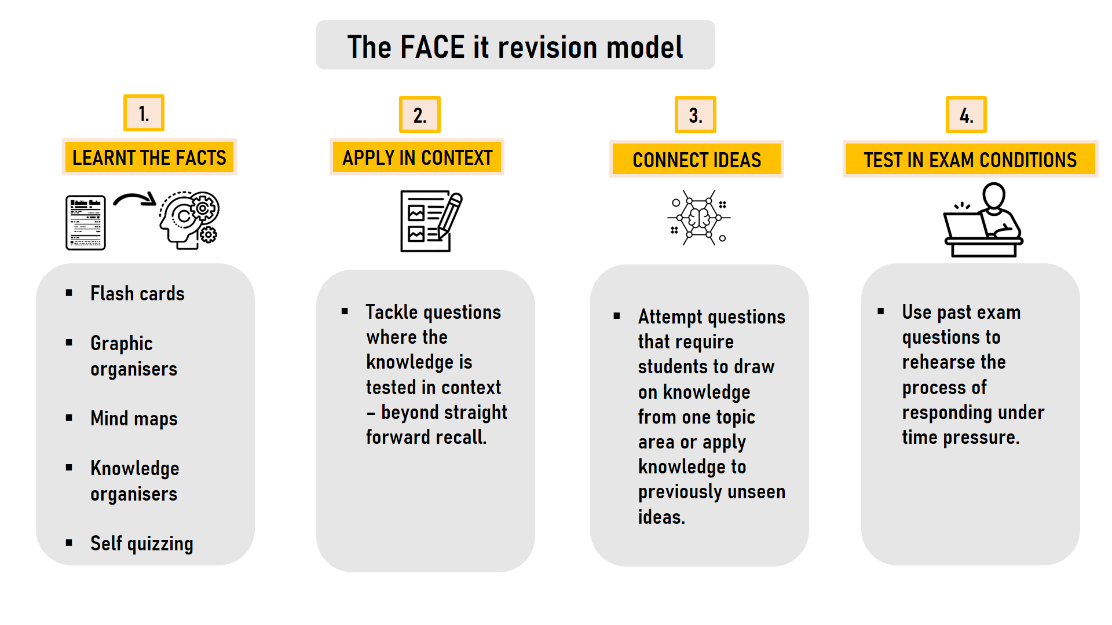

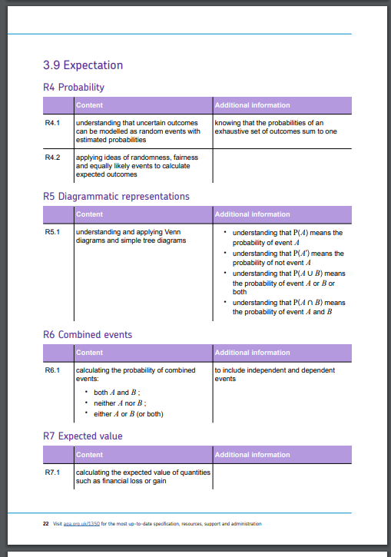
Preparing for revision
Subject specific FACE IT revision model.
This will help scaffold your revision techniques.
2. GCSE topic check lists for each paper
3. Specification for each unit (on website).

Slide 18
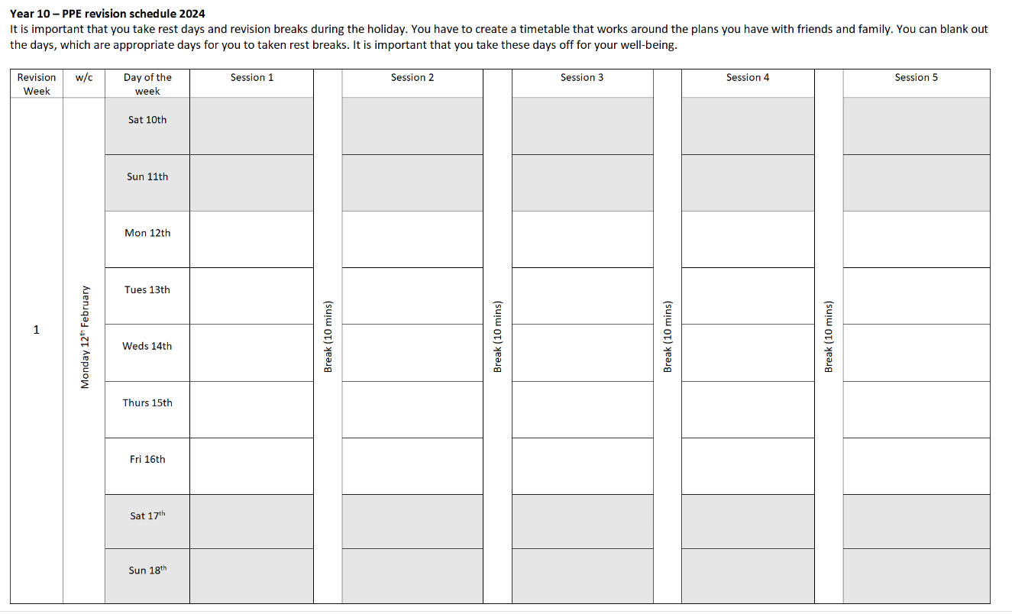
Revision timetable – This should incrementally start in October half term

Slide 19

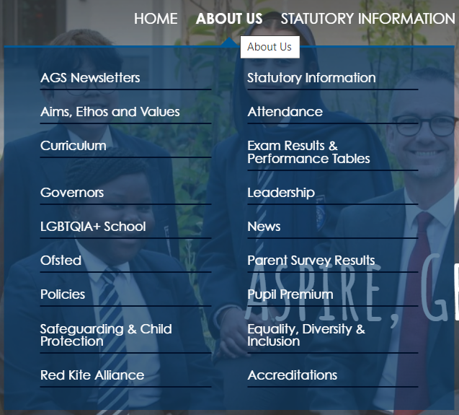
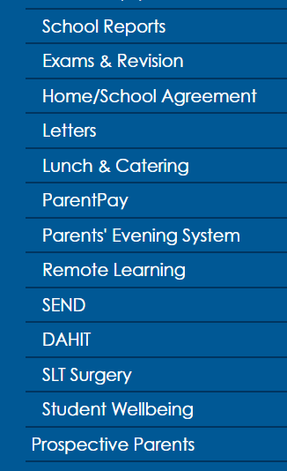
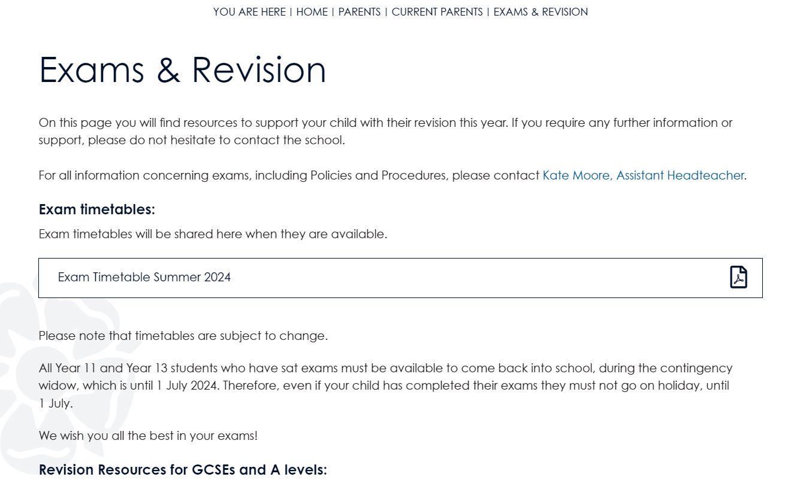
Online resources
1.
2.
3.

Slide 20



Creating an environment for concentration
Leave mobile phones in a different room.
Work with a clear desk.
Quiet Space.

Slide 21
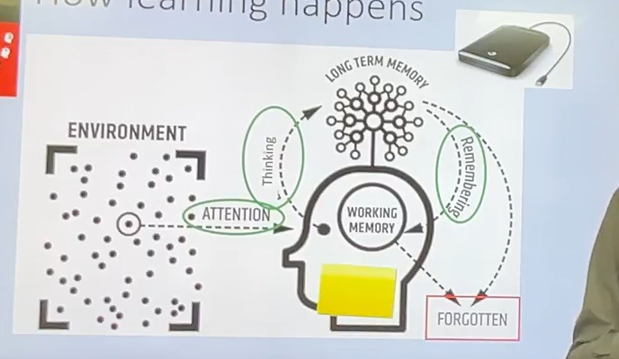
How students' learn?

Slide 22
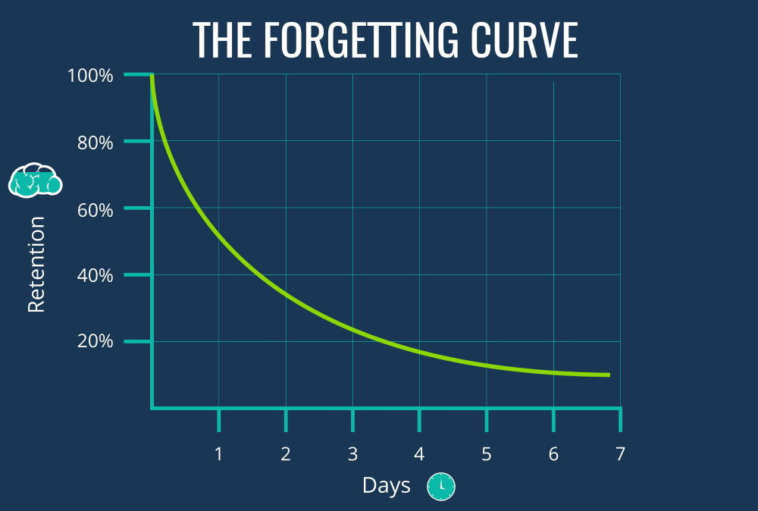

Slide 23




The FACE it revision model
1.
2.
3.
4.
LEARNT THE FACTS
APPLY IN CONTEXT
CONNECT IDEAS
TEST IN EXAM CONDITIONS
Flash cards
Graphic organisers
Mind maps
Knowledge organisers
Self quizzing
Tackle questions where the knowledge is tested in context – beyond straight forward recall.
Attempt questions that require students to draw on knowledge from one topic area or apply knowledge to previously unseen ideas.
Use past exam questions to rehearse the process of responding under time pressure.

Slide 24

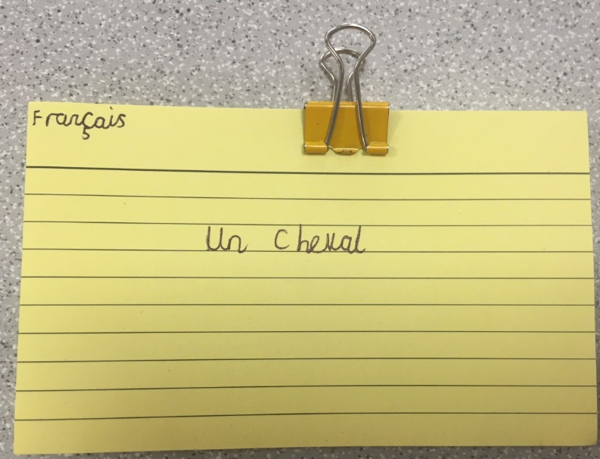
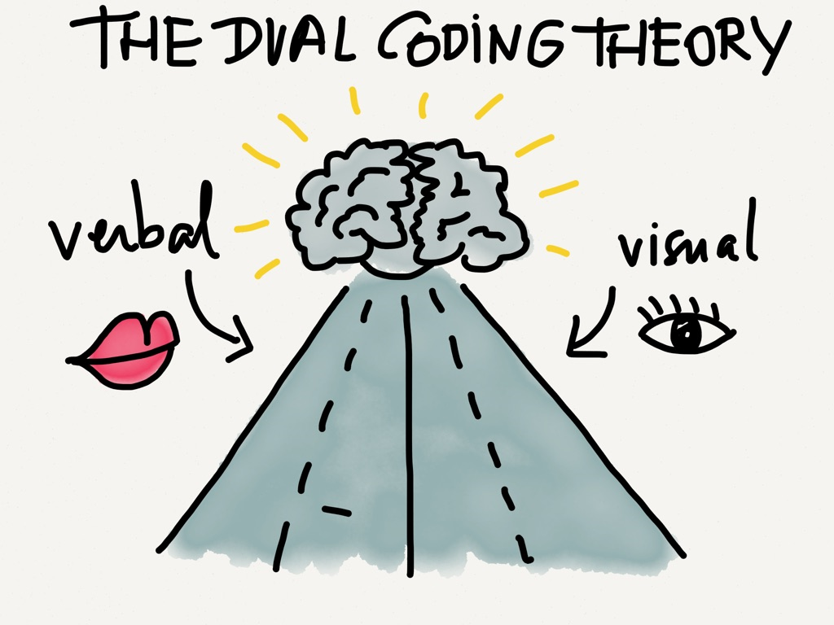
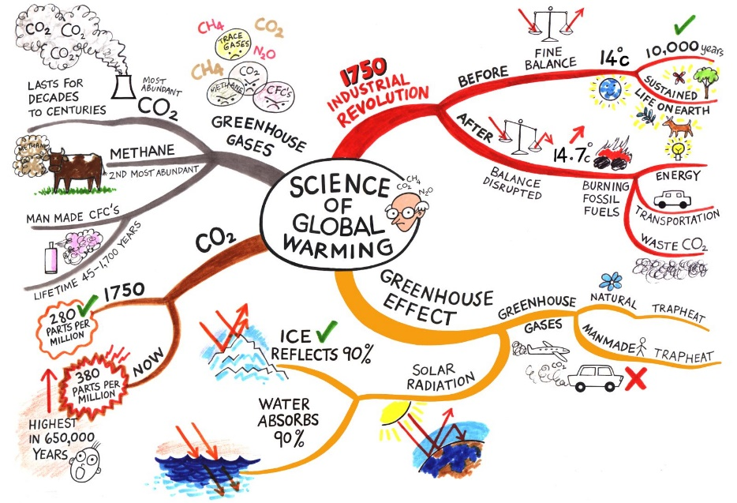
1.
LEARNT THE FACTS

Slide 25
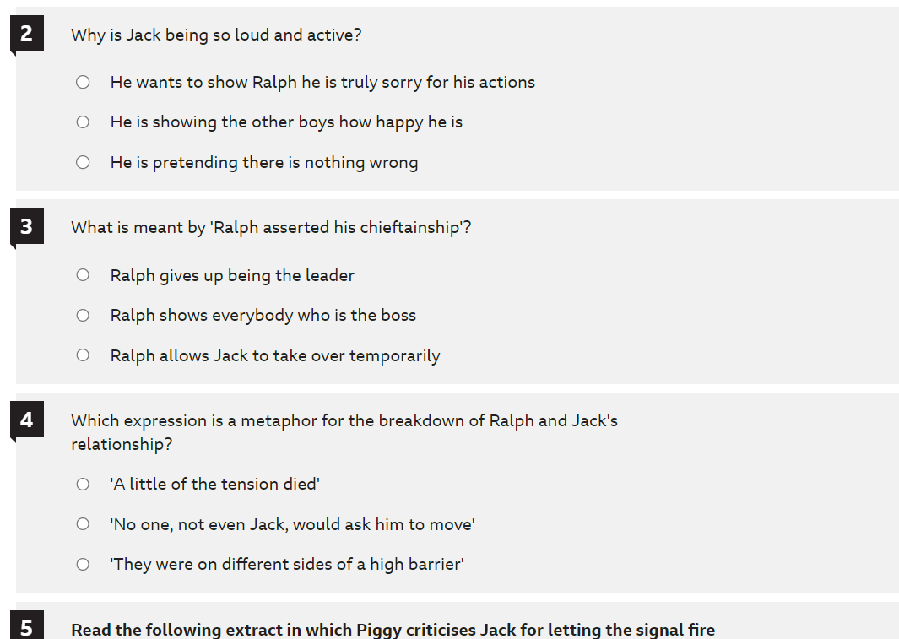
2.
APPLY IN CONTEXT

Slide 26
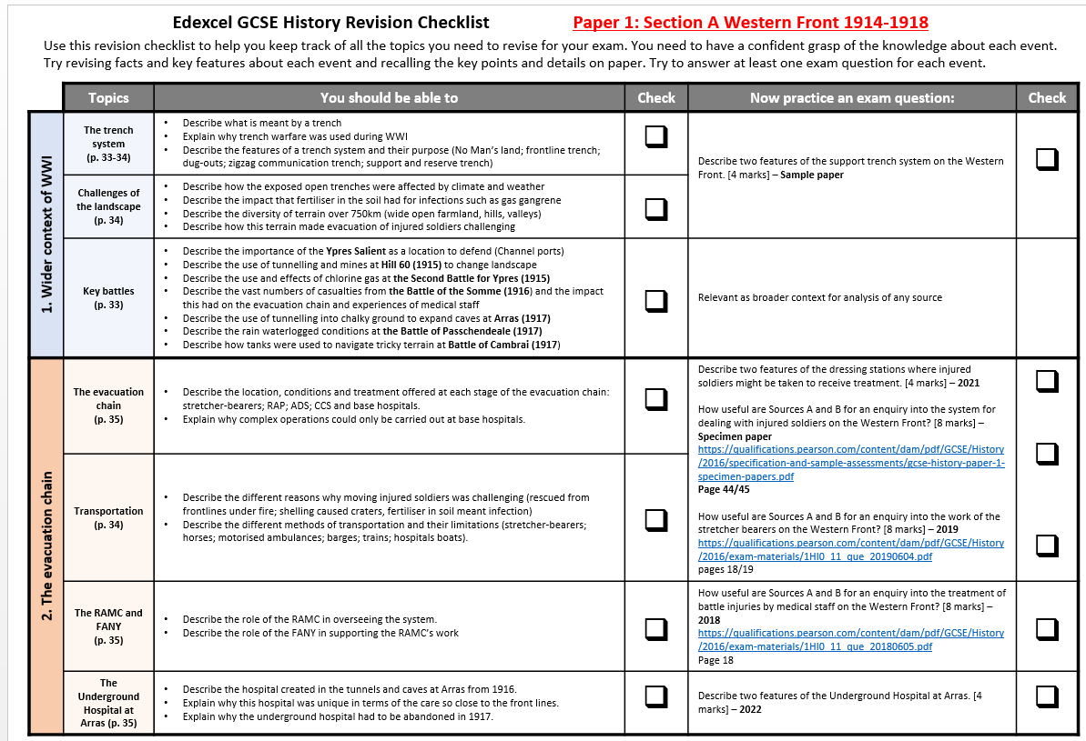
3.
CONNECT IDEAS

Slide 27
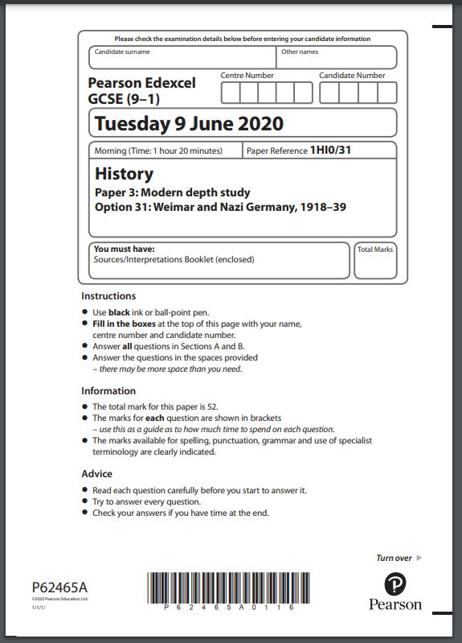

4.
TEST IN EXAM CONDITIONS
Silent conditions at a table/desk.
Stick to the precise timings of the examination.
I hour 20 minute

Slide 28
AGS examination boards: GCSE
AQA
Art (3D design, fine art, photography and textiles)
Biology
Chemistry
Physics
Combined Science
Drama
English Language
English Lit
French
Spanish
German
Geography
PE
RS (Short course and full course)
Edexcel
Business
History
Maths
OCR
Classics
Comp Science
Health & Social Care
WJEC
Music
Hospitality
VTCT
Hair & beauty

Slide 29
Post – 16
Options and Applications

Slide 30
Careers Support
Mrs Mills is the Allerton Grange Careers Lead
louisemills@allertongrange.com
I work Monday - Thursday

Slide 31
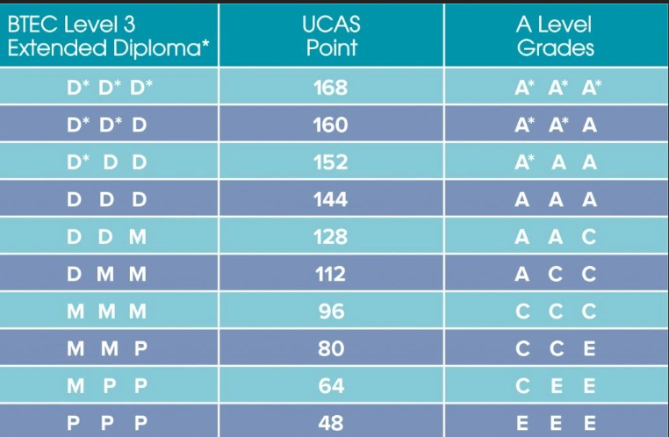
BTEC vs A Levels for University
Considerations
University course
The university
What post-16 option will give me the best result?
Post-16 course/s

Slide 32
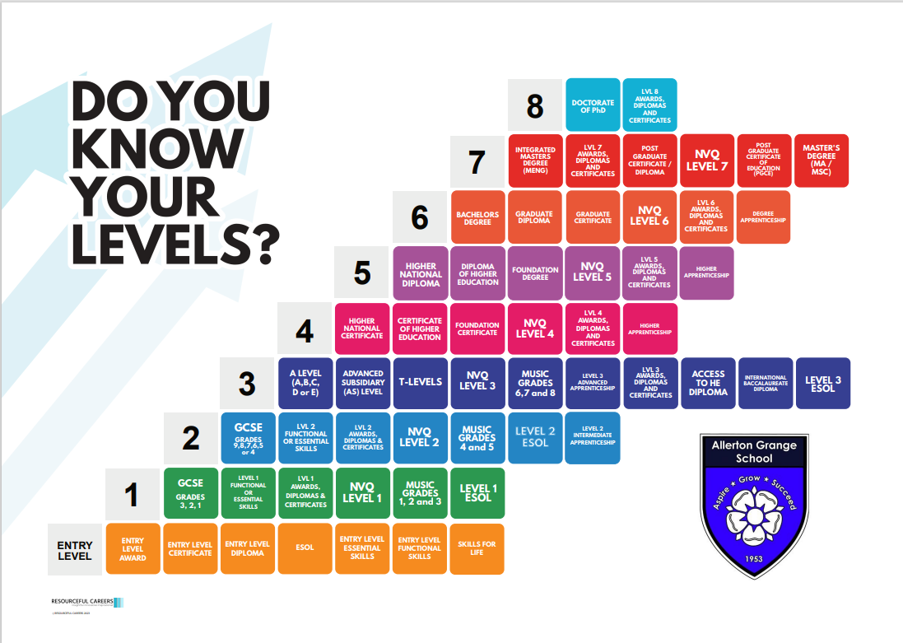

Slide 33
Applications and Deadlines
All colleges will consider applications as soon as they are made.
Applications will open in October (each college will vary slightly)
The majority of 6th Form Colleges will close applications in December
Do some research and be informed (grade requirements for specific courses/professions)
Students MUST to make a minimum of TWO applications! This includes a back-up.

Slide 34
Careers Support – Key Dates
Thursday 3 October from 4.30-6.30pm - AGS Careers Fair.
From Monday 14 October – students can drop-in to the library during lunchtime to speak to Mrs. Mills (I am also very often in the Year 11 pod during form times).
Thursday 14th November - Year 11 Mock Interviews
The letter sent out earlier this term has the dates for local college open days, copies are also available this evening.
Allerton Grange Sixth Form Open Evening is at 6pm on Thursday 7 November.

Slide 35
Apprenticeships
Apprenticeships are becoming more and more popular, as they are mutually beneficial for employers and employees.
Apprenticeships are usually 80% work and 20% college.
Apprenticeships are available in a wide range of jobs and industries.
Students often apply directly to the company for an apprenticeship, in the same way as you apply for jobs.
Leeds City College does offer some apprenticeships which are advertised on their website.
Leeds College of Building also offers apprenticeships, but the student must find their own employer.
Students who have 4 or more passes at GCSE can apply for Level 3(Advanced) apprenticeships. Students who do not have 4 passes can apply for Level 2 (Intermediate) apprenticeships.

Slide 36
Apprenticeships – where to find them
The government apprenticeships website
Company websites
Job websites (Reed, Indeed, Monster Jobs etc.)
Linkedin
UCAS
Contacts!

Slide 37









What happens if my child is struggling to find a place on a course at college next September?

Slide 38
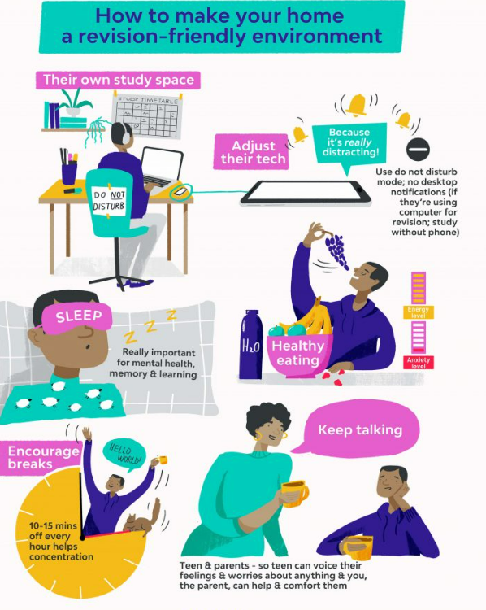
Well-being
Exam worry - normal
Talk to friends and family
Ask for help.
Be kind to yourself
Plan in breaks – exercise
Plan fun!
Eat well
Don't compare yourself to others
Pastoral teams - contact
Kooth, Samaritans, ChildLine, The Education Hub

