Slide 1
Year 11 Supporting Success Evening 2024

Slide 2
Agenda:
GCSE exams – operational aspects
Planning for effective revision
Revision strategies
AGS – GCSE intervention
Well-being and support

Slide 3
GCSE examinations 2024
w/c 22nd April – Art/Tech/Photography and MFL Home languages GCSE exams
w/c 29th April – MFL speaking examinations begin
7th May 2024 – GCSE examinations begin in the hall.
21st June 2024 – GCSE examinations finish
Students must be available to come into school until 1st July official contingency period is over.

Slide 4
7th May 2024* - GCSE exams begin
6 weeks until they start (from w/c 25th March 2024)
Still time to make an impact
*Practical subjects may have some elements of the final assessments before then.

Slide 5
GCSE examinations 2024
Exceptional circumstances are exceptional
Return to complete pre-pandemic examinations – standards and expectations
Support your child’s attendance throughout the examination period
Late arrivals
We have to inform the exam board
Possible penalties e.g. marks deducted

Slide 6
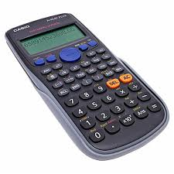
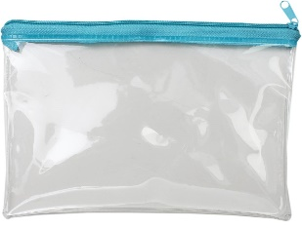
Equipment
Clear pencil case
BRING A PEN!!
Water bottle - no label or writing
General exam stationary
Calculator - NO LID
Remember: possession of unauthorised material is breaking the rules, even if you do not intend to use it, and you will be subject to penalty and possible disqualification
NO PHONES
NO WATCHES
NO NOTES
NO HEADPHONES
Notes:
5 minute task:
1 minute individually to jot down ideas – eg:
Prepare for the day
Make sure has the right equipment
Care for them
Know them well
1 minute to share ideas on the table
3 minutes to feed back to room
Staff encouraged to jot down ideas on their own copy
Share the points from the role of a form tutor

Slide 7
GCSE Grading system

Slide 8
Results Day - Thursday 22nd August 2024
Students have to provide consent for the CL to access their script
Permission slip signed by the student on the day
Student has to e-mail to provide permission if your child does not collect their script
Concerns with exams – e-mail the Subject Curriculum leader
Career’s adviser available

Slide 9
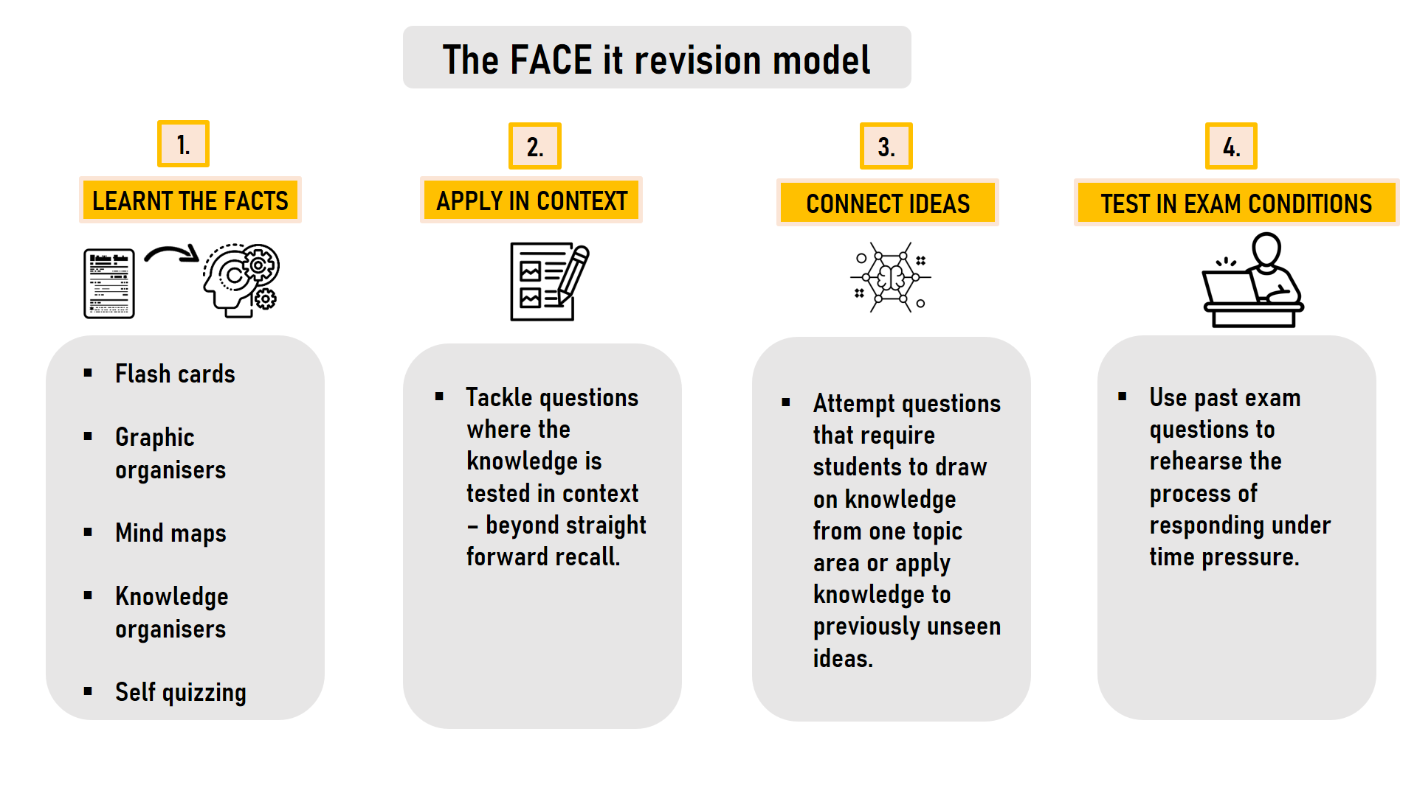
Clarity of revision
Subject specific FACE IT revision model.
This will help scaffold your revision techniques.
2. GCSE topic check lists for each paper
3. Specification for each unit (on website).

Slide 10
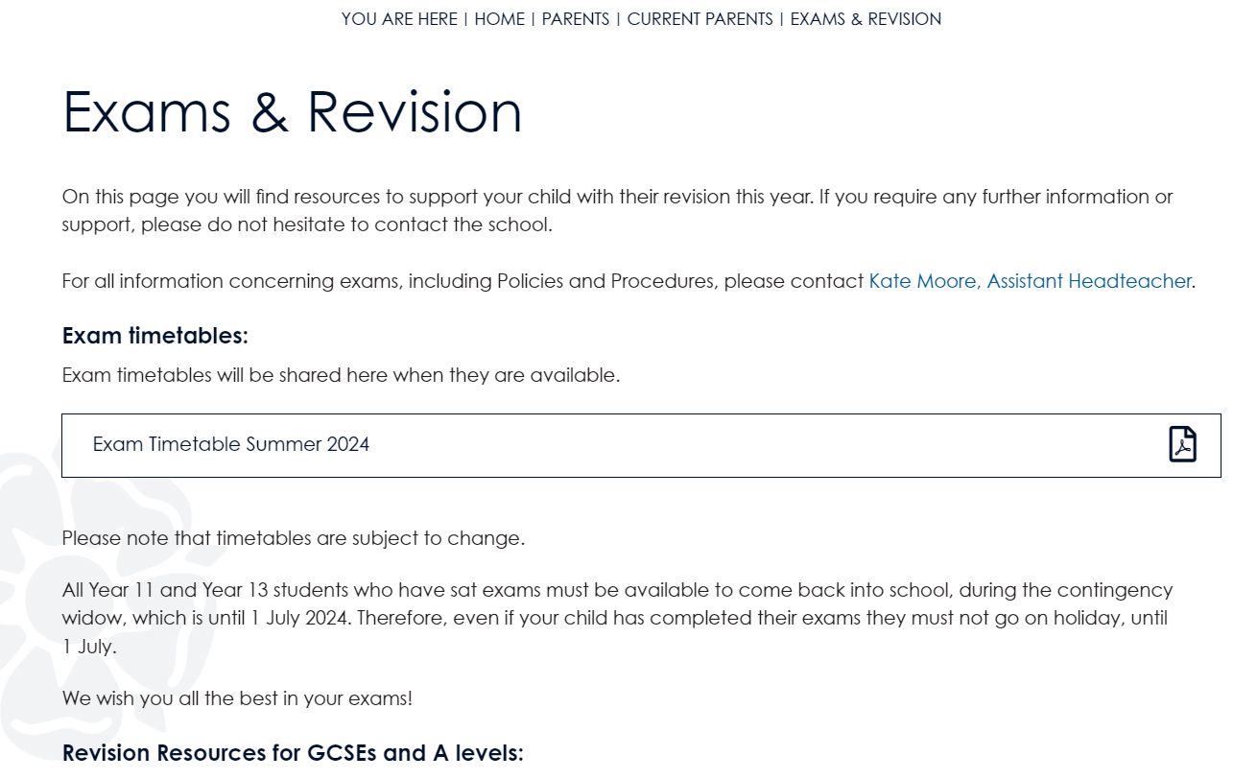
Online resources
1.
2.
3.

Slide 11
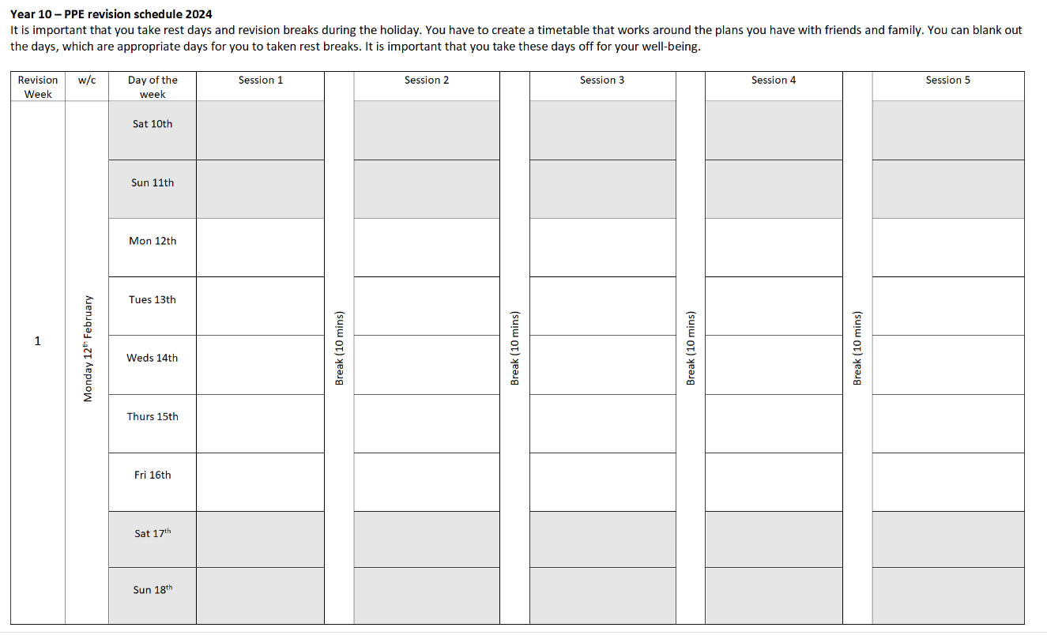
Plan revision

Slide 12
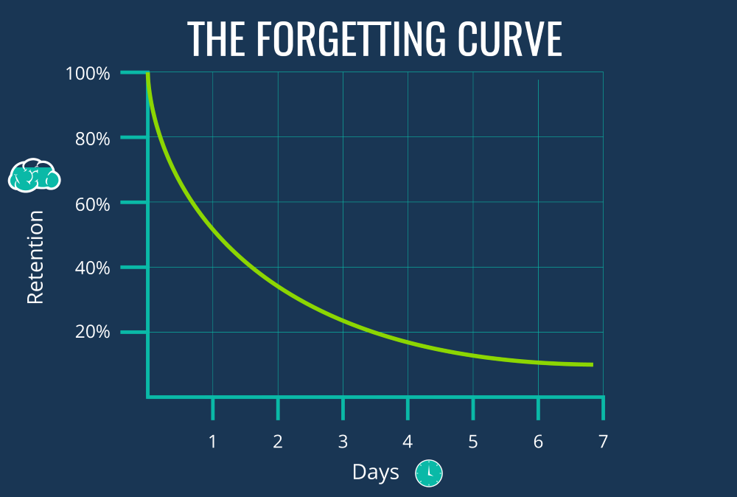

Slide 13
Maximising revision
Interleaving
1. Short sessions – 30 minutes
2. Switch between topics
3. Include breaks
4. Mix it up
The opposite of cramming
Notes:
4. For example, if they are revising trigonometry, they should avoid answering all questions about calculating an angle and then all about calculating a length. It is better if they do them in a random order. That way, they will be learning how to find out the answer from the question, instead of already knowing which formulae to use.

Slide 14
Maximizing Revision
Interleaving
GCSE Biology includes:
Health
Responses to the environment
Evolution
Ecology
Cells
Photosynthesis
Organisms and their environments • Protein functions and uses
Respiration
Genetics
Speciation
Chunk down revision
Specific topics not generic subjects
It’s best to deal with each element or topic of the course.
The opposite of cramming
Notes:
4. For example, if they are revising trigonometry, they should avoid answering all questions about calculating an angle and then all about calculating a length. It is better if they do them in a random order. That way, they will be learning how to find out the answer from the question, instead of already knowing which formulae to use.

Slide 15
Maximising revision
Spaced Retrieval
short, sharp bursts of learning
Revisit and self-test
Builds memory recall
Day 1
End of week 1
Week 2
Week 3
Involves planning a revision schedule

Slide 16
The FACE it revision model
1.
2.
3.
4.
LEARNT THE FACTS
APPLY IN CONTEXT
CONNECT IDEAS
TEST IN EXAM CONDITIONS
Flash cards
Graphic organisers
Mind maps
Knowledge organisers
Self quizzing
Tackle questions where the knowledge is tested in context – beyond straight forward recall.
Attempt questions that require students to draw on knowledge from one topic area or apply knowledge to previously unseen ideas.
Use past exam questions to rehearse the process of responding under time pressure.

Slide 17
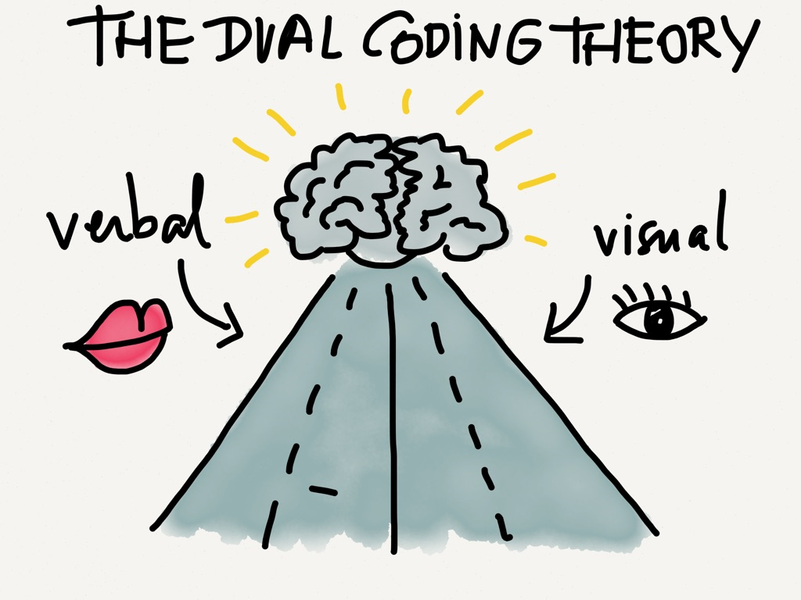
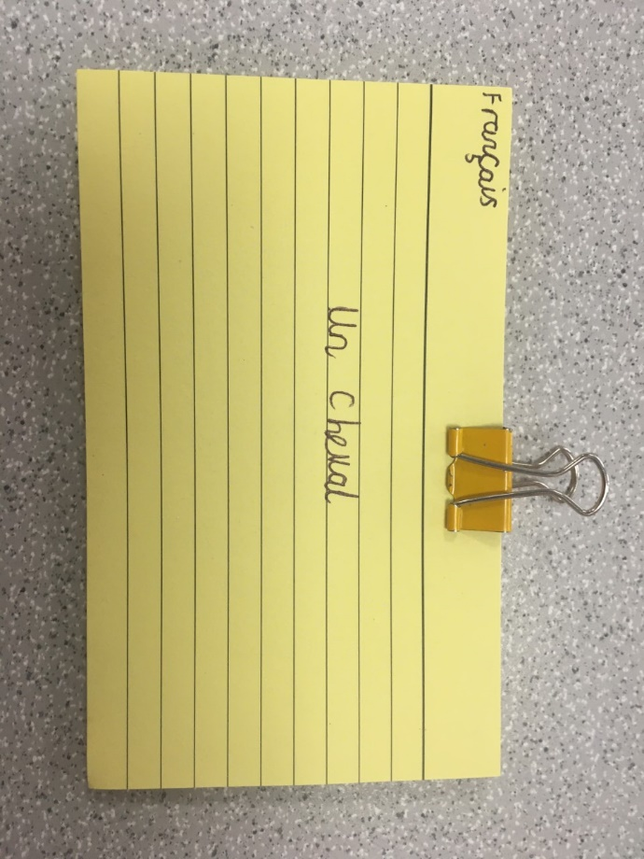
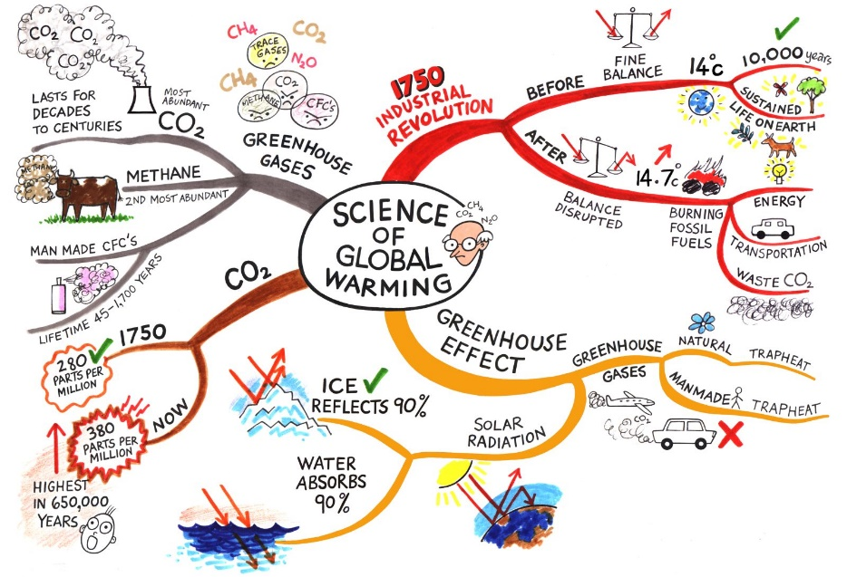
1.
LEARNT THE FACTS

Slide 18
Flash Cards
A flash card is a small piece of card of paper which is used to help remember key information from a topic or subject
On one side … | On the back …
A question | The answer
French / Spanish / German vocabulary or phrases | A translation
A formula | Use of this formula in a context
A quotation from a book or poem | An analysis of the quotation, picking about key points
Key terminology that is specific to a subject | The definition
An exam question e.g. 12 mark question | How to structure your response
Part of a process, cycle or story | Details of the process, cycle or story – mix them up and reorder into a sequence

Slide 19
Look, cover, check

Slide 20
Mind maps
Images cues – memory recall

Slide 21
Mind Maps – revision approach
Balance. No longer 30 mins.
Learn it. Physical layout. Start in the middle and work out.
Test it. Verbalise to a member of your family. What can you recall?
Reflect. Any missed areas? Go back to the content and review what you have included.
Adapt. Add additional content in another colour.

Slide 22
Dual Coding
Divide page in half: verbal and visual
2. Fold it in half so you can only see the images and try to explain the topic area using only the visual cues available.

Slide 23
2.
APPLY IN CONTEXT
Application question
Short responses
Low stakes questions

Slide 24
2.
APPLY IN CONTEXT
Business
Drama

Slide 25
3.
CONNECT IDEAS
Broader questions
You might have to compare/evaluate/use two skills to problem solve.
This will show that your knowledge relates to other parts of the broader schema.
High stakes questions, involving multiple stages.

Slide 26
3.
CONNECT IDEAS

Slide 27
4.
TEST IN EXAM CONDITIONS
Silent conditions at a table/desk.
Stick to the precise timings of the examination.
I hour 20 minute

Slide 28
METACOGNITION
Is about the ways learners monitor and purposefully direct their learning.
3. Evaluation
1. Planning
2. Monitoring
COGNITION
It is the thinking. It is the mental process of knowing and understanding.
‘Metacognition’ adapted from Metacognition and Self-regulated Learning Guidance (EEF, 2018)

Slide 29
Three areas to focus on, to improve your grades
2. Homework engagement
Successful GCSE results
3. Revision strategies
1. Class Engagement
March 2024 Predicted grades given
Closing the ‘gap’ in your knowledge is the key to the next steps.

Slide 30
Reading for pleasure is the single most important predictor of academic success Clark and DeZoya (2011)

Slide 31
Why is Reading important?
Reading enhances access and understanding in all subjects
Supports good mental health
Supports the teenage brain to think more creatively
Encourage your teenager to read little and often: 5-10 mins per evening is the best approach to begin with
Thank you for your support. Any questions, please email Sophie Halaka (Curriculum Leader for English) – sophiehalaka@allertongrange.com

Slide 32
English Language GCSE
Exam board: AQA
Paper 1: Explorations in Creative Reading and Writing – 1hr45mins
Section A: reading, Section B: writing – Thursday 23rd May
Paper 2: Writers’ Viewpoints and Perspectives – 1hr45mins
Section A: reading, Section B: writing – Thursday 6th June

Slide 33
English Literature GCSE
English Literature GCSE
Exam board: AQA
Paper 1: Shakespeare and the 19th century novel – 1hr 45mins
Macbeth and A Christmas Carol – Monday 13th May
Paper 2: Modern texts and poetry – 2hrs 15mins
An Inspector Calls, Power and Conflict Poetry Anthology, Unseen Poetry – Monday 20th May

Slide 34
English revision materials
Revision – on the website
FACE-it revision method
Students are welcome to borrow revision books from the department – these must be signed for and returned after the exams – just speak to your class teacher

Slide 35
Maths resources
Maths
Maths revision guides & workbooks
Maths Genie – practice papers, mark schemes, walkthrough videos.
Corbett Maths –worksheets and exam questions.
Sparx Maths*
- practice topics online
- different degrees of difficulty
- can track their progress.
Pinpoint Learning* - bespoke topic lists and questions based on previous topics of difficulty.
(*Sparx and Pinpoint logins needed. Speak to their Maths teachers).

Slide 36
Maths - Exam Dates
Paper 1 – Thursday 16 May – Non-calculator
Paper 2 – Monday 3 June – Calculator
Paper 3 – Monday 10 June – Calculator

Slide 37
Maths - Other help
Ask your teacher!
The Maths teachers are always on hand to answer questions the students may have, and will always make time to discuss a question that has caused any difficulty.
If students do this, they should be prepared with the question that they would like to go through.

Slide 38
AGS Interventions
Academic mastery – every morning
After school revision
Mon | Tues | Weds | Thurs | Fri
Art A03 3.00 -4.00 p.m. | Art A03 3.00 -4.00 p.m. | Art A03 3.00 -4.00 p.m. | Art A03 3.00 -4.00 p.m. | Art A03 3.00 -4.00 p.m.
 | English English pod 3.00 p.m. – 3.45 p.m. | Geography L022 3.10-4.00 p.m. | History L027 3.10-4.00 p.m. All students | Computer Science I001 3.00 – 4.00 p.m.
 |  | History L027 3.10 – 4.10 p.m. Aiming for a Grade 4 | PE L44 3.00 – 3. 50 p.m.
 |  |  | English English pod 3.00 p.m. – 3.45 p.m.

Slide 39
Dealing with distractions
Leave mobile phones in a different room.
Work with a clear desk.
Quiet Space.

Slide 40
Well-being
Exam worry - normal
Talk to friends and family
Ask for help.
Be kind to yourself
Plan in breaks – exercise
Plan fun!
Eat well
Don't compare yourself to others
Kooth, Samaritans, ChildLine, The Education Hub

