Slide 1
Welcome to Allerton Grange School 24th June 2025

Slide 2
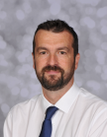
The Year 7 team
​
Darren Wall
Year 7 Progress & Welfare Coach
Connie Wright
Year 7 Progress & Welfare Manager

Slide 3
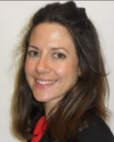
Wider support
Sarah Whittingham Assistant Head teacher, Safeguarding & Welfare & Year 7 Link
Michaela Child Assistant Head teacher, Special Educational Needs & Disabilities Co-ordinator (SENDCo)
Kate Moore Deputy Headteacher
Culture, Behaviour and Attitudes​

Slide 4
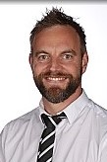
KS3 Leadership team
Leanne Hosty
KS3 Progress & Welfare Leader & Head of Transition​
Assistant Head teacher, Director of Key Stage 3

Slide 5
Steve Fidler - Director of KS3
Core Student-Focused Responsibilities:
Academic Monitoring and Intervention
Pastoral Care and Behaviour Management
Transition Support (Year 6 to Year 7)
Curriculum Oversight (KS3)
Tracking and Reporting
Promoting Student Development
Inclusion and Support

Slide 6
Leanne Hosty
KS3 Progress & Welfare Leader & Head of transition
Visits to primary school
Transition process from hereon
What Year 6 students have done during their first 2 days with us
Form groups

Slide 7
Supporting your child to thrive
September 2025
Extended form time with Year 7 to support them settling into the school.

Slide 8
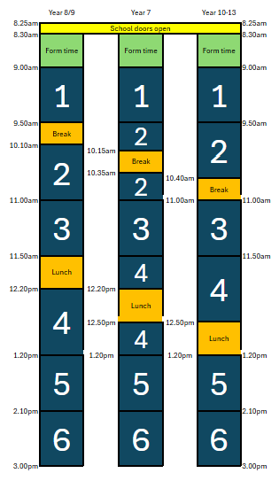
School Day
08:25 – The school building opens to students
Registration/Tutor Time 08:30-09:00
Session 1 09:00-09:50
Session 2 09:50-11:00
includes Break time 10:15-10:35
Session 3 11:00-11:50
Session 4 11:50-1.20pm
includes Lunch 12:20-12:50
Session 5 1:20pm-2:10pm
Session 6 2:10pm-3:00pm

Slide 9
Year 7 only 2nd Sept 2025
First week – students bring cash or packed lunch.
First day - issued with a PIN number for purchasing lunch from Chartwells (our school food company).
Student’s food accounts can have money deposited into them via ParentPay.
Allergies – Please make school aware of any allergies.
Colleagues are in the foyer if you need to discuss this today

Slide 10
Uniform & PE kit
Please label all items of clothing with your child’s name
Design School Uniform & Workwear 21-23 The Headrow Leeds LS1 6PU 0113 243 6642 www.designschooluniform.co.uk | Rawcliffes 617- 619 Roundhay Road Leeds LS8 4AR 0113 249 4025 www.rawcliffesleeds.co.uk | School Uniform Shop / Jo Brand 369-373 Harehills Lane Harehills Leeds LS9 6AP 0113 235 1256 www.uniwears.co.uk | School Uniform Shop / Jo Brand 18-20 Green Road Meanwood Leeds LS6 4JP 0113 230 6272 www.uniwears. co.uk

Slide 11
School Uniform Exchange
Open to all parents and carers.
This includes:
AGS branded uniform eg blazers, jumpers, PE kit
Non-branded uniform eg white shirts, grey trousers, grey skirts
If you would like to request any items, please send an email and include the sizes needed to vikimciver@allertongrange.com and we will check what we have available, and let you know.

Slide 12
Allows you to ‘top up’ online - www.parentpay.com
You must top up and then ‘allocate items’ to pay for meals or trips etc.
Enables you to monitor what your child is eating
Details of how to access ParentPay can be found on our stall outside and on the school website
Further details will be posted out to you in September

Slide 13
Communication
Please download the ClassCharts app to your phone at your earliest convenience.
It is the most direct form of communication and allows the teacher, parents, student relationship to be accurate.
Pupil
Parent

Slide 14
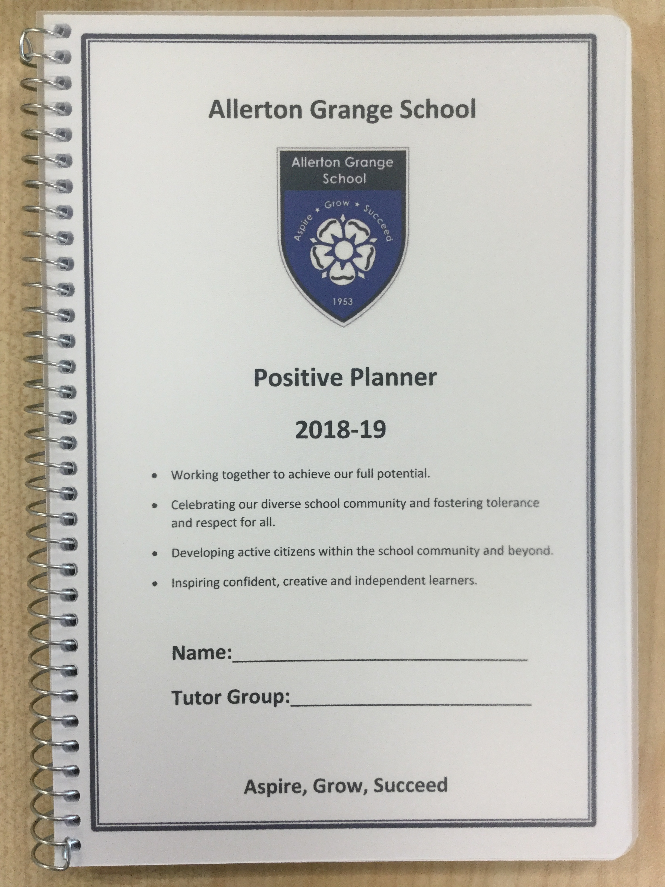
The first port of call every day is form time and registering with the form tutor
Daily checks on well-being and safeguarding
Builds a relationship of trust
Checking uniform and equipment
Checking planners
Supporting with our Policy of Positive Discipline
Knowledge organisers

Slide 15
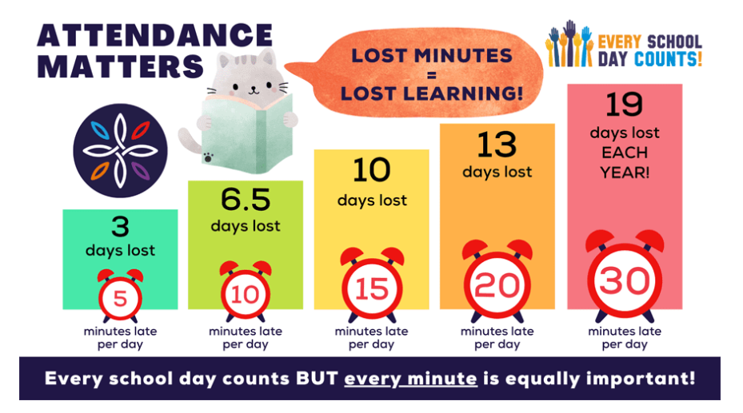

Slide 16
If your child will not be attending school, parents must inform the school attendance team via the ClassCharts app.
90% attendance is equivalent to 1 day of absence per fortnight
AGS is consistently above the national average for attendance
Week beginning 20th May:
National = 87.4%
AGS = 93.2%
Year to date (24th May):
National = 91.1%
AGS = 93.2%

Slide 17
Organisation for Learning
The following equipment is essential for all students:
Bag - large enough to hold several books and equipment
Pen - black and blue but also a green pen
Pencil
Sharpener
Ruler
Rubber
Calculator- scientific if possible
Glue stick
Planner - provided in September
Tissues (on a needs basis)
Whiteboard pen

Slide 18
Planners
Organisation
Mini White Board – formative assessment
Method of communication
Please read your child’s Planner with them. It includes really important information on uniform, equipment, homework, laboratory rules, the KLAS Curriculum and Aspirational achievement

Slide 19
Languages
All students will study either French, German or Spanish
If you have already expressed a preference for a certain language, we will do our best to accommodate this, but cannot guarantee it

Slide 20
Homework at AGS extends the knowledge that is developed in school and allows students to consolidate, enrich and extend their learning.
Homework is set via ClassCharts
Parents can review and support homework. Student log-ins are issued in the first week in September
Retrieving, consolidating, embedding

Slide 21
Student Leadership opportunities
Community Ambassadors
Student leadership group
Reading Mentors
Sports Ambassadors
Student Wellbeing Ambassadors
Attendance Ambassadors
Foreign Language Ambassadors

Slide 22
Extra Curricular enrichment and Music Tuition
Music Tuition
If your child is entitled to Free School Meals, they are also eligible for free music tuition to learn one instrument.
All students are encouraged to take part in the wide range of extra- curricular activities and after school clubs on offer:
Rock Band / Concert Band / Samba Band / Jazz Band / Choir
Drama Club / School Musical / Duke of Edinburgh Award / Spectrum
Rugby / Football / Netball/ Badminton / Athletics / Cricket / Rounders

Slide 23
School Events
Parents are encouraged to attend school events such as:
Information Evenings
Open Evenings
Awards Evenings
Parents’ Forum
Music and drama performances
We want to create an open and supportive school community to encourage communication. See our website and Facebook page for dates and times.

Slide 24
What we love about AGS...

Slide 25
Culture and community
Sense of belonging
Year 7 support – extended form time
Official welcome to AGS - Matriculation

Slide 26
There is a tangible sense of community and celebration of diversity at Allerton Grange School.
Teachers and pupils have strong relationships and show great respect for each other. This is really welcoming and diverse school...
Ofsted inspection report ( April 2025)

Slide 27
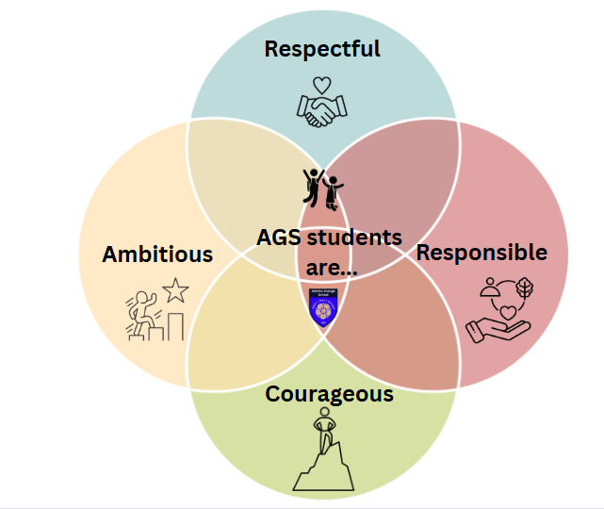
Character Counts Curriculum

Slide 28
The Allerton Grange KLAS Curriculum
Our guarantor of equality
Knowledge : More knowledge
Literacy : More understanding
Service and leadership : More ambition
Aspirational enrichment : More experiences

Slide 29
What we are proud of...

Slide 30
Ofsted report (April, 2025)

Slide 31
Policy for Positive Discipline
Focus on recognising positive behaviour and celebrating positive character traits and efforts
Zero hero awards
Attendance
Allertonian spirit
Excelling excellence
Pre-Christmas rewards event.

Slide 32
Policy for Positive Discipline
Consequences
Clear, Proportionate and fair.
Develops responsibility
Parents will be informed (via text or the ClassCharts app) 24-hours prior to any detention

Slide 33
Mobile Phones
All devices switched off when students arrive at school.
No ear pods or mobiles are allowed to be used anywhere on site.
Mobile phones, headphones, ear buds and other devices must be kept switched off at the bottom of bags or in lockers.
If devices are seen or heard in school, a behaviour point will be issued, and they will be confiscated and held until 4 pm that school day.

Slide 34
Please note fizzy drinks and energy drinks are not allowed in school.

Slide 35
Parental engagement with AGS community
Parental meetings - prearranged
We will not be able to meet with you if no appointment is booked.
Pastoral team are supporting all students
Contact by phone/e-mail – response – 24 hours
Biannual reports
Parent Survey
Virtual PCE
AGS community
4Matrix
Class Charts
Awards evenings
www.allertongrange.com
@Allerton_Grange
Allerton Grange School

Slide 36
Michaela Child - Assistant Head teacher
Special Educational Needs & Disabilities Co-ordinator (SENDCo)

Slide 37
SEND rationale at AGS
Powerful knowledge starts from the idea of equal citizens with an equal entitlement to knowledge.
Adaptations
barriers are removed
additional support
SEND students access the full breadth of the KLAS curriculum.

Slide 38
SEND at Allerton Grange
Student passports shared with all teachers
Passports will be emailed out in September. Parent input welcome.
Assessments/Screening
Graduated approach
Intervention packages put in place to meet need on half termly basis
SEND surgery, parent’s evenings and review day
Please share diagnostic or other helpful paperwork with us
send@allertongrange.com
AHT/SENDCo – Michaela Child
Assistant SENDCo – Jane Dempster
SEND Admin – Sally Lostroh
Dyslexia/literacy – Andrea Petersen
Neurodiversity Coach – Carolyn Suguira
SEMH Coach – Kirstie Fry
VI/SLCN - Kate Ludlow
Teacher of SEND – Katherine Neilson

Slide 39
We look forward to seeing you in September Year 7 only 2nd Sept 2025
Notes:
Do not forget to collect the leaflets on ParentPay etc on the stall in your exit. Thanks ever so much for your time this evening, we look forward to seeing you in September. Have a safe and enjoyable Summer holiday!!!

