Slide 1


Welcome to Allerton Grange School
25 June 2024

Slide 2
School Values
Our principles to Aspire, Grow, and Succeed underpin everything we do at Allerton Grange.
Aspire – We want everyone at Allerton Grange to be the best they can be and therefore we set the very highest expectations for all members of our school, regardless of background or ability. We expect the highest standards of behaviour and attitude; uniform and organisation
Grow – At Allerton Grange we ensure that the opportunities are available for all students to improve and develop. We provide excellent teaching and an intervention programme to support students academically. We provide many student leadership opportunities which allow our young people to grow as individuals.
Succeed – Our commitment to improvement delivers success which we celebrate with students and staff. The quality of teaching at Allerton Grange ensures that students make swift progress above that expected nationally. Students are rewarded constantly for meeting the expectations the school sets.

Slide 3
Presentation aims
Year 7 key members of staff
Attendance & punctuality
Uniform, equipment & planners
Form groups/tutors
The KLAS Curriculum
Events
All will be on the website

Slide 4
Year 7 – Key members of staff
Steve Fidler Assistant Headteacher, Director of Key Stage 3
Sarah Whittingham Assistant Headteacher, Safeguarding & Welfare
& Year 7 Link
Michaela Child Assistant Headteacher, Special Educational Needs & Disabilities Co-ordinator (SENDCo)
Leanne Hosty KS3 Progress & Welfare Leader & Head of Transition
Connie Wright Year 7 Progress & Welfare Manager
Darren Wall Year 7 Progress & Welfare Coach
Form tutors which your child will have met over the last two days

Slide 5

Steve Fidler - Director of KS3
Thank you for choosing this school and for entrusting us with, what we expect to be the next 7 years of your child's education.
The school community are very proud of what we have achieved and aim to achieve over the next 5 - 7 years.

Slide 6
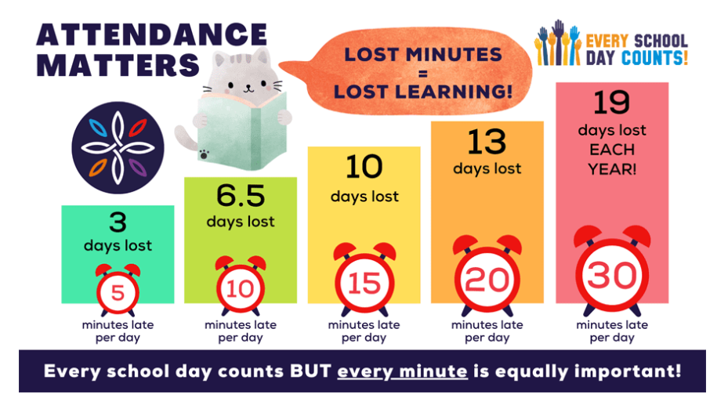

Steve Fidler
Director of KS3

Slide 7

If your child will not be attending school, parents must inform the school attendance team via the ClassCharts app.
90% attendance is equivalent to 1 day of absence per fortnight
AGS is consistently above the national average for attendance
Week beginning 20 May:
National = 87.4%
AGS = 93.2%
Year to date (24 May):
National = 91.1%
AGS = 93.2%

Slide 8

To help you get instant information about attendance, homework, achievements and any sanctions we use ClassCharts.
Please download the ClassCharts app to your phone at your earliest convenience.
It is the most direct form of communication and allows the teacher, parents, student relationship to be accurate.
Pupil
Parent

Slide 9
Leanne Hosty
KS3 Progress & Welfare Leader & Head of transition
Visits to primary school
Transition support booklet
Transition process from hereon
What Year 6 students have done during their first 2 days with us
Form groups

Slide 10

Starting a new school in Year 7 can be a worrying time for both students and parents. We have systems in place and will work closely with you to ensure the transition is as smooth as possible.
The Year 7 team are very experienced, always approachable and are available throughout the school day.

Slide 11
Uniform & PE kit
Please label all items of clothing with your child’s name
Design School Uniform & Workwear 21-23 The Headrow Leeds LS1 6PU 0113 243 6642 www.designschooluniform.co.uk | Rawcliffes 617- 619 Roundhay Road Leeds LS8 4AR 0113 249 4025 www.rawcliffesleeds.co.uk | School Uniform Shop / Jo Brand 369-373 Harehills Lane Harehills Leeds LS9 6AP 0113 235 1256 www.uniwears.co.uk | School Uniform Shop / Jo Brand 18-20 Green Road Meanwood Leeds LS6 4JP 0113 230 6272 www.uniwears.co.uk

Slide 12
School Uniform Exchange
We run a School Uniform Exchange to help reduce waste, reuse nearly new clothing and help everyone save some money. It is open to all parents and carers.
This includes:
AGS branded uniform eg blazers, jumpers, PE kit
Non-branded uniform eg white shirts, grey trousers, grey skirts
If you would like to request any items, please send an email and include the sizes needed to vikimciver@allertongrange.com and we will check what we have available, and let you know.

Slide 13

Equipment
The following equipment is essential for all students:
Bag - large enough to hold several books and equipment
Pen - black and blue but also a green pen
Pencil
Sharpener
Ruler
Rubber
Calculator - scientific if possible
Glue stick
Planner - provided in September
Whiteboard pen

Slide 14
Planners
All students will receive a positive planner from school to help them develop organisational skills
Parents and teachers can use the planner as a method of communication
Please read your child’s Planner with them. It includes really important information on uniform, equipment, homework, laboratory rules, the KLAS Curriculum and Aspirational achievement

Slide 15

Please help your child get organised
Please help your child with their organisation by discussing their timetable, helping them prepare their bag the night before, helping them to get their uniform out ready (PE kit different)

Slide 16
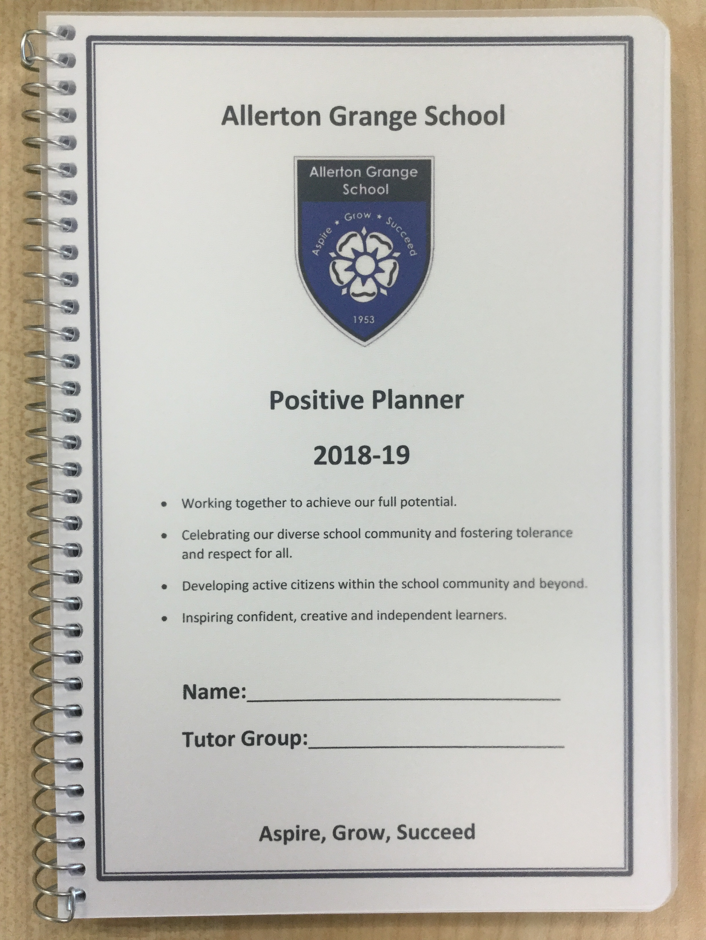
The first port of call every day is form time and registering with the form tutor
Daily checks on well being and safeguarding
Builds a relationship of trust
Checking uniform and equipment
Checking planners
Commending achievements point and supporting with behaviour
Knowledge organisers

Slide 17
Sanctions
If any students are struggling with our Policy for Positive Discipline we will implement intervention strategies
In the unlikely event that your child receives a detention, parents will be informed (via text or the ClassCharts app) 24-hours prior to any detention

Slide 18

Mobile Phones
Students must switch off mobile phones and other devices when they arrive at school.
Mobile phones, headphones, ear buds and other devices must be kept switched off at the bottom of bags or in lockers.
If devices are seen or heard in school, they will be confiscated and held for 48 hours.

Slide 19
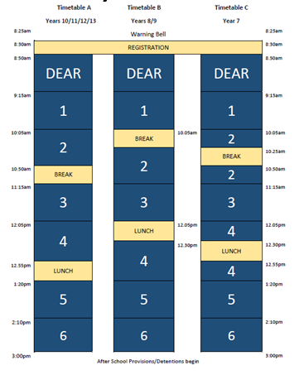
School Day
08:15 – The school building opens to students
Registration/Tutor Time 08:30-08:50
Drop Everything And Read 08:15-09:15
Session 1 09:15-10:05
Session 2 10:05-11:15
includes Break time 10:25-10:50
Session 3 11:15-12:05
Session 4 12:05-13:20
includes Lunch 12:30-12:55
Session 5 13:20-14:10
Session 6 14:10-15:00

Slide 20

Lunchtime
Students can bring cash to pay for lunches or a packed lunch during the first week.
On the first day, they will be issued with a PIN number for purchasing lunch from Chartwells (our school food company).
Student food accounts can have money deposited into them via ParentPay
Allergies – Please make school aware of any allergies.
Please note fizzy drinks and energy drinks are not allowed in school.

Slide 21

Allows you to make online payments
via www.parentpay.com
Once you have set up your ParentPay account, you can add money for your child to pay for lunches.
You ‘top up’ and then ‘allocate items’ to pay for meals or trips etc.
Please remember to check in the evening that your child has enough money for the next day.
Enables you to monitor what your child is eating.

Slide 22
Details of how to access ParentPay can be found on our stall outside and on the school website
Further details will be posted out to you in September

Slide 23

The Allerton Grange KLAS Curriculum
Our guarantor of equality
Knowledge : More knowledge
Literacy : More understanding
Service and leadership : More ambition
Aspirational enrichment : More experiences

Slide 24
Knowledge
The Curriculum at Allerton Grange and the quality of education it creates is one of our proudest achievements
Every subject area has a knowledge rich Curriculum, designed with a purpose to enable students to gain powerful knowledge and engage in highly intelligent conversations for the greater good of overcoming social imbalance.
All teachers ‘teach to the top’, using research to inform and develop their pedagogy and ensure that knowledge is embedded for the long term.

Slide 25
What will this look like in the classroom?
Teaching:
Rigorous and challenging curriculum
Direct instruction
Research-informed/evidence-based practice
Mastery of powerful subject knowledge
High expectations, scaffolded for SEND students
Learning:
We expect students to read widely and use crucial subject terminology fluently.
Respond to feedback and challenge with resilience
Display a desire to achieve mastery

Slide 26

Michaela Child - Assistant Head teacher
Special Educational Needs & Disabilities Co-ordinator (SENDCo)

Slide 27
SEND at Allerton Grange
‘There is clearly ambition across the school for what pupils with SEND can achieve... the vast majority of pupils follow the same KLAS curriculum as all other learners. Leaders believe this is an entitlement. -Local Authority Review, June 23
Student passports shared with all teachers
Passports will be emailed out in September. Parent input welcome.
Assessments/Screening
Graduated approach
Intervention packages put in place to meet need
SEND surgery, parents evenings and review day
send@allertongrange.com
AHT/SENDCo – Michaela Child
Assistant SENDCo – Jane Dempster
SEND Admin – Sally Lostroh
Dyslexia/Literacy – Andrea Petersen
Neurodiversity Coach – Molly Dunne
SEMH Coach – Kirstie Fry
Teacher of SEND – Katherine Neilson
Please share diagnostic or other helpful paperwork with us

Slide 28
The English Baccalaureate
Introduced in 2010, the government’s ambition was to see 75% of pupils studying the EBacc subject combination at GCSE by 2022, and 90% by 2025.
What is the EBacc?
The EBacc is a set of subjects at GCSE that keeps young people’s options open for further study and future careers. The EBacc is English language and literature, Maths, the Sciences, Geography or history & a language
‘’Studying the Core EBACC subjects including a language can help gain access to the countries best universities’’ DfE
Subjects provided in all years from September 2023
Computer Science
Classics

Slide 29



Languages
All students will study either French, German or Spanish
If you have already expressed a preference for a certain language, we will do our best to accommodate this, but cannot guarantee it

Slide 30

Homework
Homework at AGS extends the knowledge that is developed in school and allows students to consolidate, enrich and extend their learning.
Homework is set via ClassCharts
Parents can review and support homework. Student log-ins are issued in the first week in September
In Year 7 homework is approx. 30 mins per subject per week

Slide 31
Literacy
Reading the right quantity of suitably stretching literature within the context of a rigorous, knowledge-based curriculum is the key to addressing the imbalance between the socially advantaged and the socially disadvantaged.

Slide 32

Our DEAR program guarantees that all AGS students read three high-quality texts each year. The form tutor supports the students by ensuring they have a complex and sophisticated understanding of the book.
Reading together in the manner of a shared journey allowing us to help children make sense of the world around them. DEAR is key to building a genuine reading culture and instilling in all our students a life-long love of literature.

Slide 33


Slide 34
Liz Braim - Assistant Head teacher
Service & Leadership
The Service and Leadership cornerstone of the KLAS Curriculum is now focussed around personal development.
Personal development further enables the core purpose of our KLAS model, being Social mobility
Enrichment

Slide 35
Enrichment – 1 session every two-weeks
From September, Year 7 students will have one timetabled enrichment lesson per fortnight, allowing further opportunities for students to Aspire, Grow and Succeed.
This means that all students will have the opportunity to take part in enrichment activities during the school day.
Students will choose from a range of options which will develop their resilience, self-belief and communication skills. The aim here is to develop leaders of the future who understand and support the wider AGS community.

Slide 36

How does this work?
Year 7
Year 8
Year 9
Eco Club | Community Clean Up | Social Action | On the Stage! | Problem Solving | Escape Rooms | Reading for Pleasure | Chess | Origami
Kitchen Chemistry | Animation | Wellbeing Workshops | Gardening | Enterprise Challenge | Ethics and Debating | Boxing | Darts | Community Walk
Football Leadership | Music Performance | Climbing | Ceramics | Marketing and Photography | Web Design | Afternoon Tea | BSL | Forensic Science
Service
Leadership and Performance
Creativity
Notes:
There are 4 reasons why we need to reconsider the role of leadership at AGS:
1. This school is transforming again (Phase 2):
a) Phase 1 (2015-2020) = securing GOOD standards required a certain approach from leaders (we’ll look at these in detail later)
b) Phase 2 (2020 – 2025) = securing exceptional quality of education will require a different approach from leaders.
2. Minimise the inspection legacy = we have to assume that we will secure a GOOD judgement this time, and having achieved that I do want us to fall into the common trap of treading water for the remainder of the year. I want us to be ready to move quickly on further school improvement.
3. We have challenged CLs to adapt their leadership approach (given them significant autonomy) but we have failed to challenge ourselves. We have become too comfortable. I would argue that this is best demonstrated at SLT meetings – there is very little challenge or debate.
4. Despite challenging CLs to develop an ambitious KRC (within the framework of the CTA policy) the PPE debate last term clearly shows there is significant variation in their knowledge of the principles and applications of the curriculum as the progression model. Therefore, how can we adequately challenge them as our SLT links if we do not possess that same knowledge.

Slide 37




Student Leadership opportunities
Community Ambassadors
Student Council
Reading Mentors
Sports Ambassadors
Student Wellbeing Ambassadors
Attendance Ambassadors
Foreign Language Ambassadors

Slide 38
Aspirational Enrichment
Aspirational Enrichment is one of the cornerstones of our KLAS curriculum. As an AGS student, you are expected to take advantage of the wide range of enrichment opportunities offered.
RESPECT YOURSELF.
RESPECT OTHERS.

Slide 39
Aspirational Enrichment
Every year you will attend an end of year enrichment trip. The trips will include visits to museums, theatres and exhibitions.
Year 7 students will go on a residential to Bushcraft Camp, where they will have an unforgettable experience camping under the stars, cooking on an open fire and trying a range of outdoor pursuits.
By the end of Year 9, all students will have been on at least two curriculum-related trips, which will extend their learning beyond the classroom.
To support you in your journey to university and work you will have least three engagement activities with an employer during their time at AGS.
RESPECT YOURSELF.
RESPECT OTHERS.

Slide 40









Key Stage 3 Extra-Curricular Activities Calendar
Term 3 – April to July
Monday | Tuesday | Wednesday | Thursday | Friday
Spectrum (LGBTQ+) Club All years – L031 | Year 8 Girls Rounders Sports Field | Year 7 Girls Rounders Fields | KS3 Coding Club I002 – Mr Stone | Software Developer Club (after May half-term) Students who have chosen computing only – I001
Library / Book Club KS3 – LRC1 | Year 9 and 10 Boys Cricket Fields | Year 9/10 Softball Fields | Darts Club (Year 9 and 10) Mr Taylor – L024 | Grade 5 Theory KS4 Lunchtime – M002
All Years Girls Basketball Sports Hall | KS3 Boys Basketball Sports Hall | Year 7/8 Boys Cricket Fields | Year 9 / 10 Rounders Netball Courts | Writers’ Collective L010
KS3 Art Club Art A003 | Year 7 Boys Rounders/Softball (after basketball) Fields | Choir Main Hall | Chess / Board Games Club L035
Year 8 and 9 Song Writing Club (Breaktime) – M003 – Mr Duff | KS3 Girls Cricket MUGA | Duff Club (Jazz Band) M003/1 – Mr Duff | STEM Club S004 – Mr Gledhill
Junior and senior Concert Band M001 (Junior) and M002 (Senior) | Drama Club KS3 – D001 | School of Rock M002 | Abstract Writing L011
Samba Lunchtimes – Storeroom 9 | Year 7 song writing club (Week A) – Lunchtime | Drama Club KS3 – D001
 | American Literature Book Club L012 | Debate Club L010
 |  | DJ Club Lunchtime 11:25-1145 Store 9
KS3

Slide 41
Extra Curricular enrichment and Music Tuition
Music Tuition
If your child is entitled to Free School Meals, they are also eligible for free music tuition to learn one instrument.
All students are encouraged to take part in the wide range of extra curricular activities and after school clubs on offer:
Rock Band / Concert Band / Samba Band / Jazz Band / Choir
Drama Club / School Musical / Duke of Edinburgh Award / Spectrum
Rugby / Football / Netball/ Badminton / Athletics / Cricket / Rounders

Slide 42

Parental engagement with AGS community
Biannual reports
If you would like to discuss anything with the school, then please book an appointment through the reception team or by emailing the Pastoral Team directly.
We will not be able to meet with you, unless you have booked an appointment.
Parent Survey
Virtual PCE
AGS community
Go4Schools
Class Charts
Awards evenings
www.allertongrange.com
@Allerton_Grange
Allerton Grange School

Slide 43

School Events
Parents are encouraged to attend school events such as:
Information Evenings
Open Evenings
Awards Evenings
Parents’ Forum
Music and Drama performances
We want to create an open and supportive school community to encourage communication. See our website and Facebook page for dates and times.

Slide 44
We look forward to seeing you in September
Training Day: Monday 2 Sept
Year 7 only: Tuesday 3 Sept
Notes:
Do not forget to collect the leaflets on ParentPay etc on the stall in your exit. Thanks ever so much for your time this evening, we look forward to seeing you in September. Have a safe and enjoyable Summer holiday!!!

